Slide 1
UNIT – II Classification: Basic Concepts, Decision Trees, and Model Evaluation
ONLINE / LIVE TEACHING CLASSES
SESSION 2021-2022

Slide 2
Classification: Definition
Given a collection of records (training set )
Each record contains a set of attributes, one of the attributes is the class.
Find a model for class attribute as a function of the values of other attributes.
Goal: previously unseen records should be assigned a class as accurately as possible.
A test set is used to determine the accuracy of the model. Usually, the given data set is divided into training and test sets, with training set used to build the model and test set used to validate it.

Slide 3
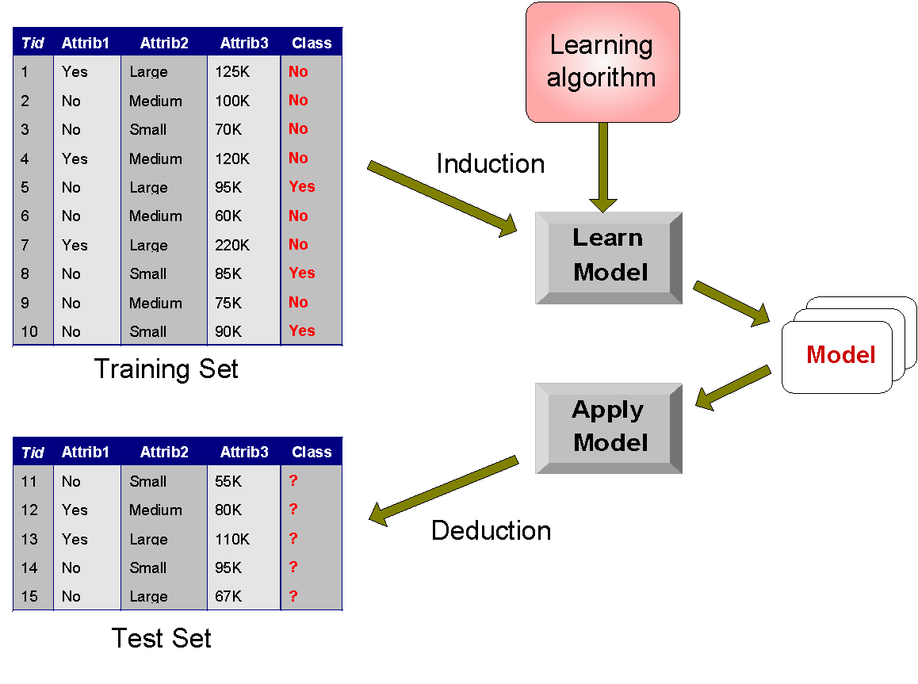
Illustrating Classification Task

Slide 4



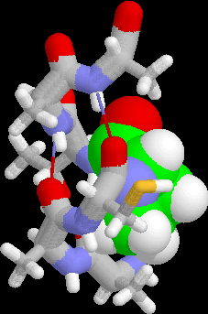
Examples of Classification Task
Predicting tumor cells as benign or malignant
Classifying credit card transactions as legitimate or fraudulent
Classifying secondary structures of protein as alpha-helix, beta-sheet, or random coil
Categorizing news stories as finance, weather, entertainment, sports, etc

Slide 5
Classification Techniques
Decision Tree based Methods
Rule-based Methods
Memory based reasoning
Neural Networks
Naïve Bayes and Bayesian Belief Networks
Support Vector Machines

Slide 6
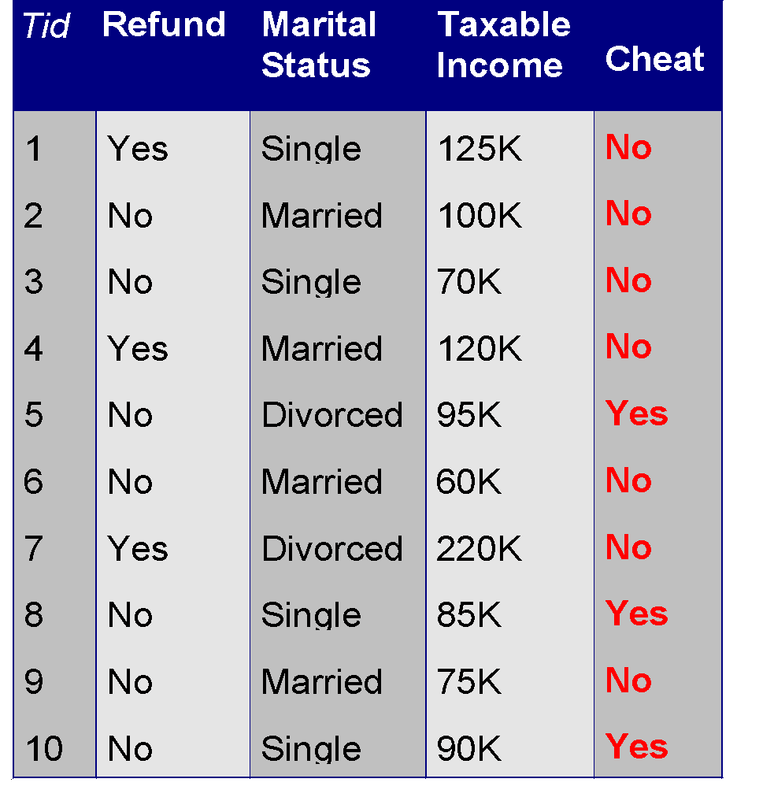
Example of a Decision Tree
categorical
categorical
continuous
class
Splitting Attributes
Refund
Yes
No
NO
MarSt
Single, Divorced
Married
TaxInc
NO
< 80K
> 80K
NO
YES
Training Data
Model: Decision Tree

Slide 7
Another Example of Decision Tree
categorical
categorical
continuous
class
MarSt
Single, Divorced
Married
NO
Refund
Yes
No
NO
TaxInc
< 80K
> 80K
NO
YES
There could be more than one tree that fits the same data!

Slide 8

Decision Tree Classification Task
Decision Tree

Slide 9
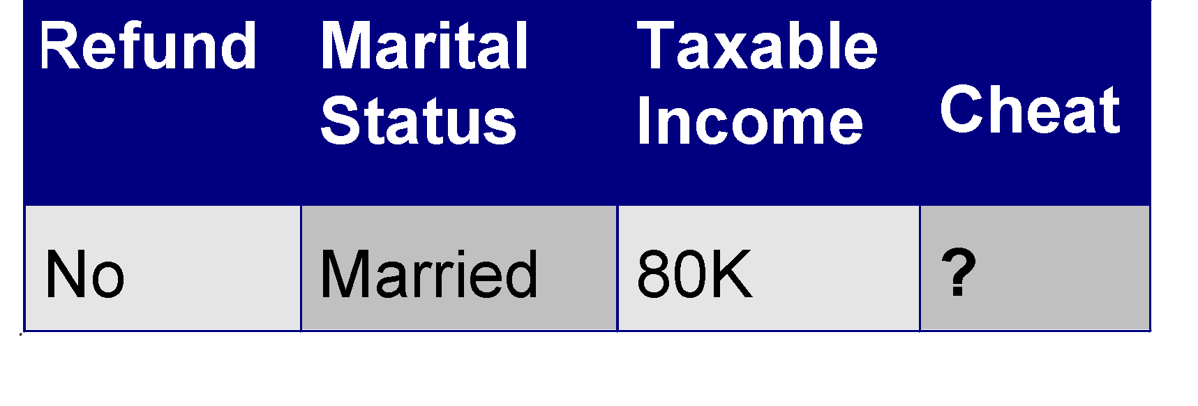
Apply Model to Test Data
Test Data
Start from the root of tree.
Refund
Yes
No
NO
MarSt
Single, Divorced
Married
TaxInc
NO
< 80K
> 80K
NO
YES

Slide 10
Apply Model to Test Data
Test Data
Refund
Yes
No
NO
MarSt
Single, Divorced
Married
TaxInc
NO
< 80K
> 80K
NO
YES

Slide 11
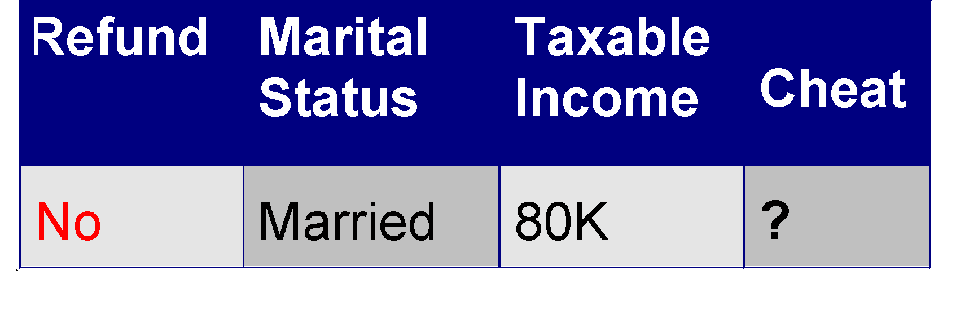
Apply Model to Test Data
Test Data
Refund
Yes
No
NO
MarSt
Single, Divorced
Married
TaxInc
NO
< 80K
> 80K
NO
YES

Slide 12
Apply Model to Test Data
Test Data
Refund
Yes
No
NO
MarSt
Single, Divorced
Married
TaxInc
NO
< 80K
> 80K
NO
YES

Slide 13
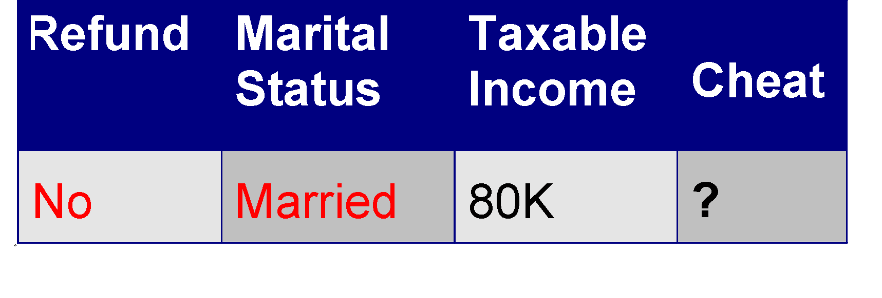
Apply Model to Test Data
Test Data
Refund
Yes
No
NO
MarSt
Single, Divorced
Married
TaxInc
NO
< 80K
> 80K
NO
YES

Slide 14
Apply Model to Test Data
Test Data
Refund
Yes
No
NO
MarSt
Single, Divorced
Married
Assign Cheat to “No”
TaxInc
NO
< 80K
> 80K
NO
YES

Slide 15
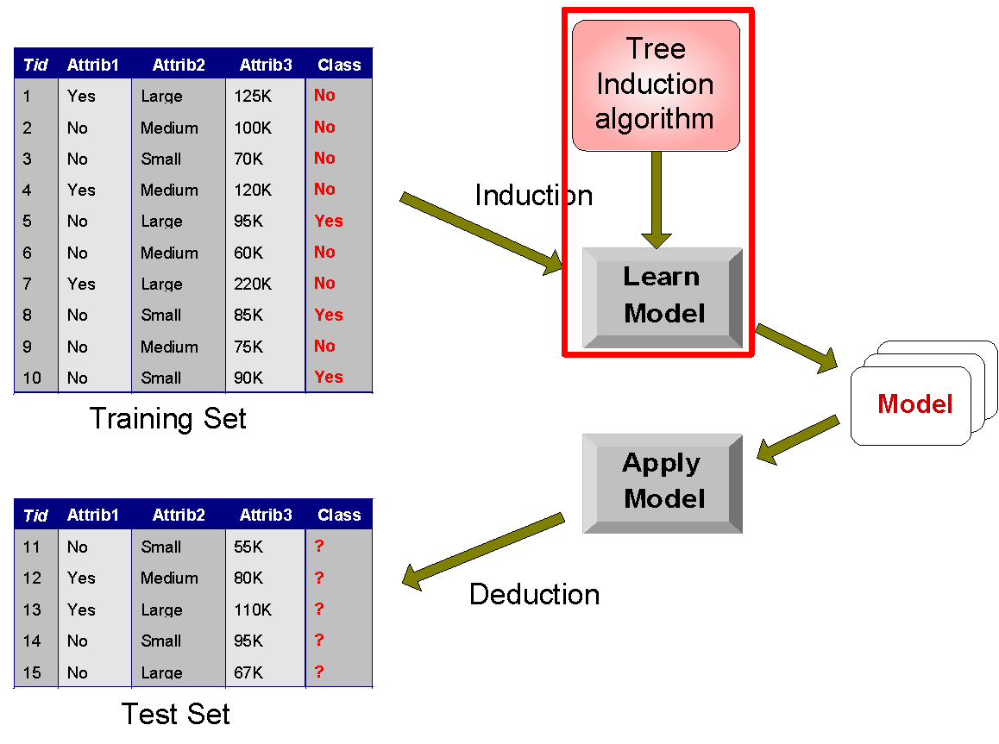
Decision Tree Classification Task
Decision Tree

Slide 16
Decision Tree Induction
Many Algorithms:
Hunt’s Algorithm (one of the earliest)
CART
ID3, C4.5
SLIQ,SPRINT

Slide 17
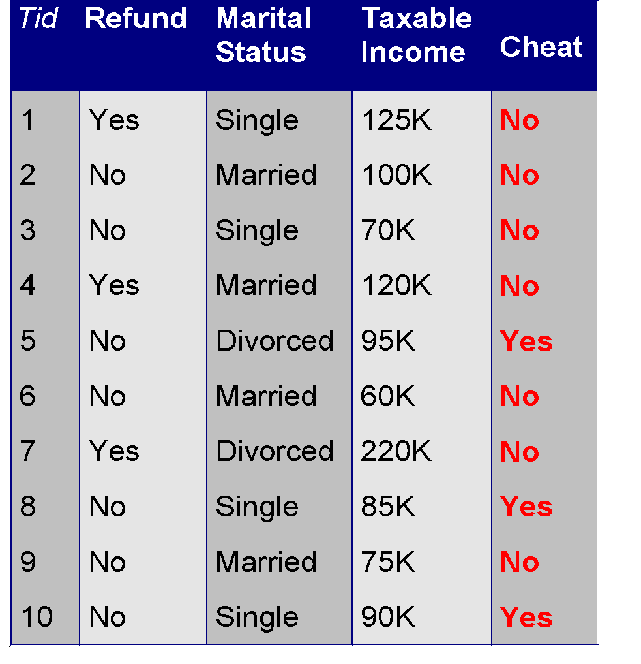
General Structure of Hunt’s Algorithm
Let D_{t} be the set of training records that reach a node t
General Procedure:
If D_{t} contains records that belong the same class y_{t}, then t is a leaf node labeled as y_{t}
If D_{t} is an empty set, then t is a leaf node labeled by the default class, y_{d}
If D_{t} contains records that belong to more than one class, use an attribute test to split the data into smaller subsets. Recursively apply the procedure to each subset.
D_{t}
?

Slide 18

Hunt’s Algorithm
Refund
Don’t
Cheat
Yes
No
Don’t
Cheat
Don’t
Cheat
Refund
Refund
Yes
No
Yes
No
Don’t
Cheat
Marital
Status
Don’t
Cheat
Marital
Status
Single,
Divorced
Single,
Divorced
Married
Married
Cheat
Don’t
Cheat
Taxable
Income
Don’t
Cheat
< 80K
>= 80K
Don’t
Cheat
Cheat

Slide 19
Tree Induction
Greedy strategy.
Split the records based on an attribute test that optimizes certain criterion.
Issues
Determine how to split the records
How to specify the attribute test condition?
How to determine the best split?
Determine when to stop splitting

Slide 20
Tree Induction
Greedy strategy.
Split the records based on an attribute test that optimizes certain criterion.
Issues
Determine how to split the records
How to specify the attribute test condition?
How to determine the best split?
Determine when to stop splitting

Slide 21
How to Specify Test Condition?
Depends on attribute types
Nominal
Ordinal
Continuous
Depends on number of ways to split
2-way split
Multi-way split

Slide 22
Splitting Based on Nominal Attributes
Multi-way split: Use as many partitions as distinct values.
Binary split: Divides values into two subsets. Need to find optimal partitioning.
CarType
Family
Luxury
Sports
CarType
CarType
{Sports, Luxury}
OR
{Family, Luxury}
{Family}
{Sports}

Slide 23
Splitting Based on Ordinal Attributes
Multi-way split: Use as many partitions as distinct values.
Binary split: Divides values into two subsets. Need to find optimal partitioning.
What about this split?
Size
Small
Large
Medium
Size
Size
{Small, Medium}
OR
{Medium, Large}
{Large}
{Small}
Size
{Small, Large}
{Medium}

Slide 24
Splitting Based on Continuous Attributes
Different ways of handling
Discretization to form an ordinal categorical attribute
Static – discretize once at the beginning
Dynamic – ranges can be found by equal interval bucketing, equal frequency bucketing (percentiles), or clustering.
Binary Decision: (A < v) or (A ≥ v)
consider all possible splits and finds the best cut
can be more compute intensive

Slide 25
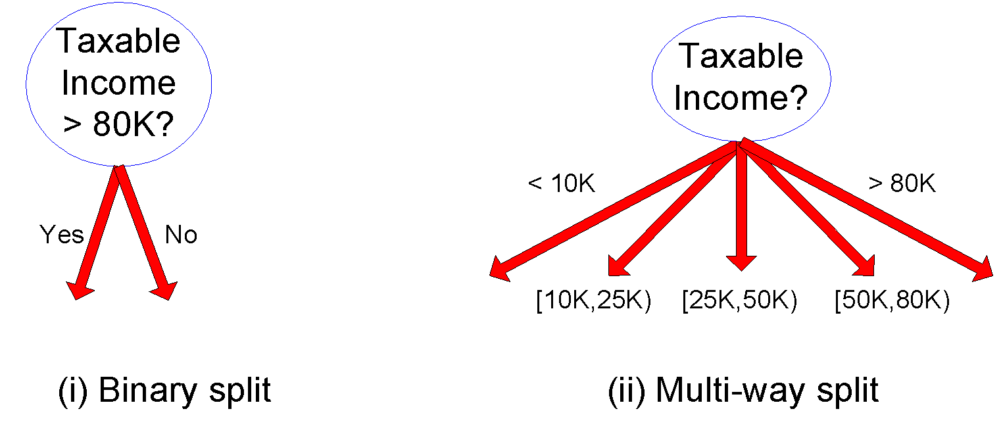
Splitting Based on Continuous Attributes

Slide 26
Tree Induction
Greedy strategy.
Split the records based on an attribute test that optimizes certain criterion.
Issues
Determine how to split the records
How to specify the attribute test condition?
How to determine the best split?
Determine when to stop splitting

Slide 27
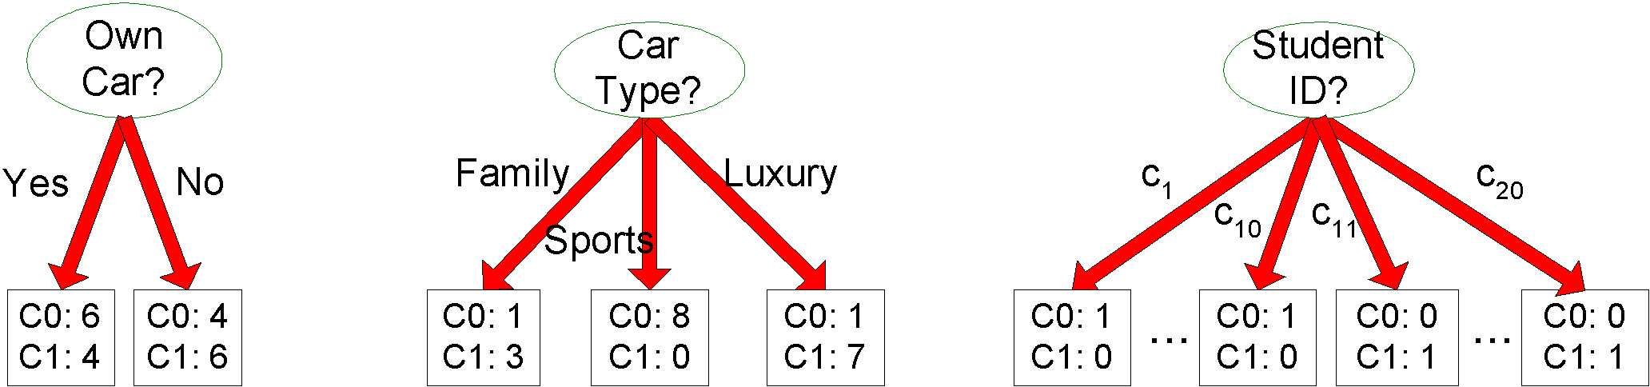
How to determine the Best Split
Before Splitting: 10 records of class 0, 10 records of class 1
Which test condition is the best?

Slide 28
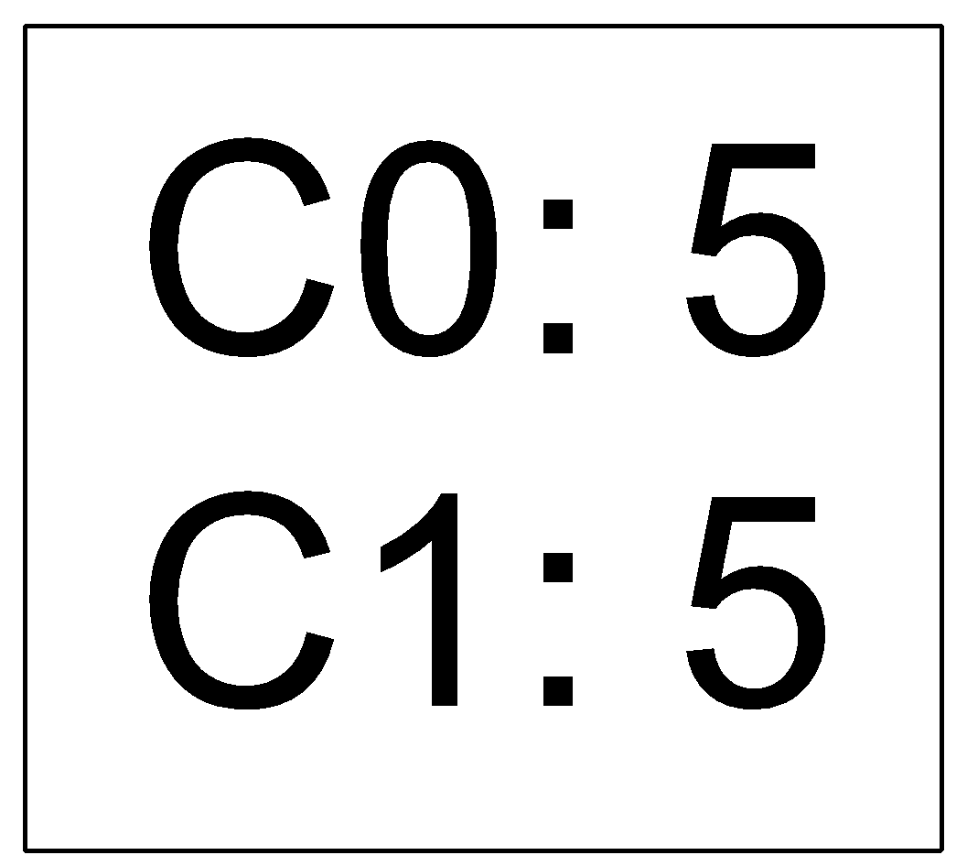
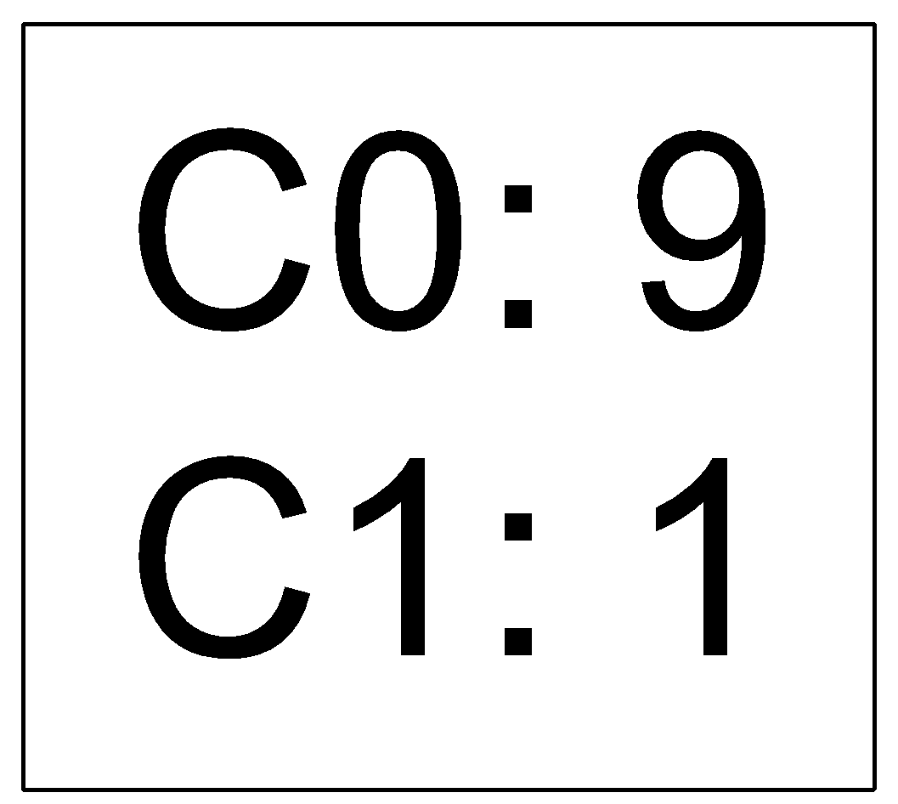
How to determine the Best Split
Greedy approach:
Nodes with homogeneous class distribution are preferred
Need a measure of node impurity:
Non-homogeneous,
High degree of impurity
Homogeneous,
Low degree of impurity

Slide 29
Measures of Node Impurity
Gini Index
Entropy
Misclassification error

Slide 30
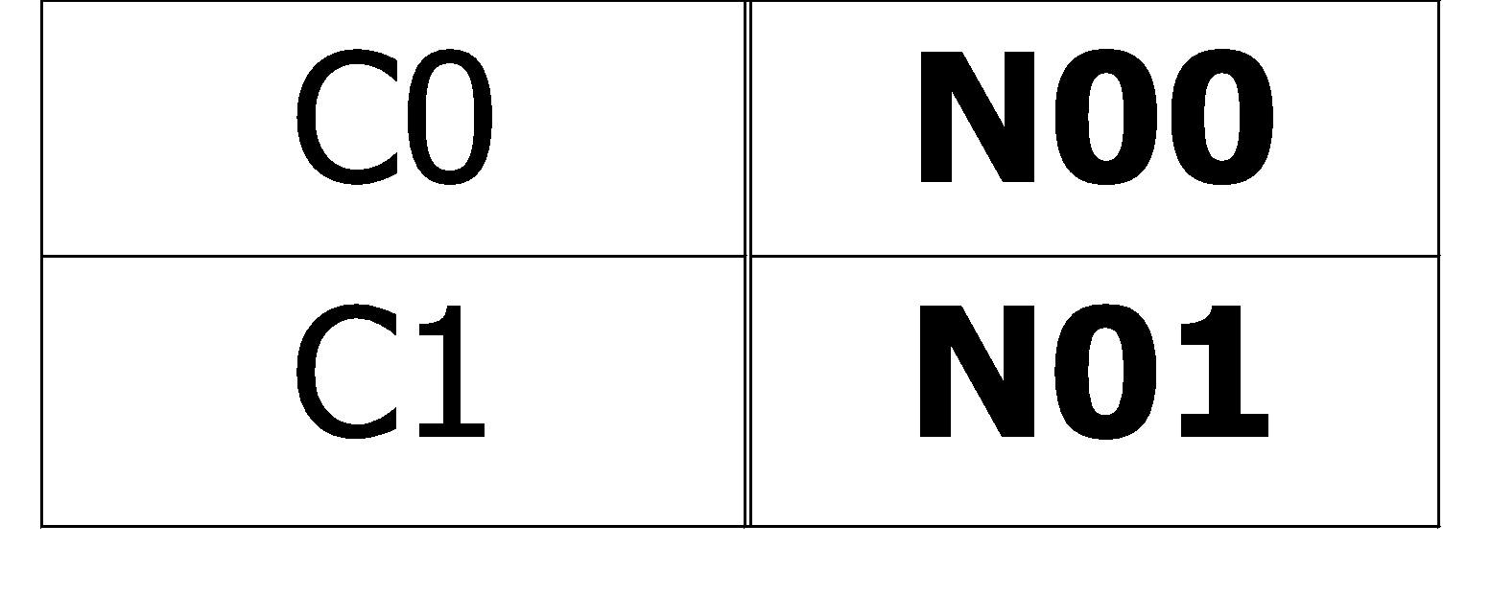
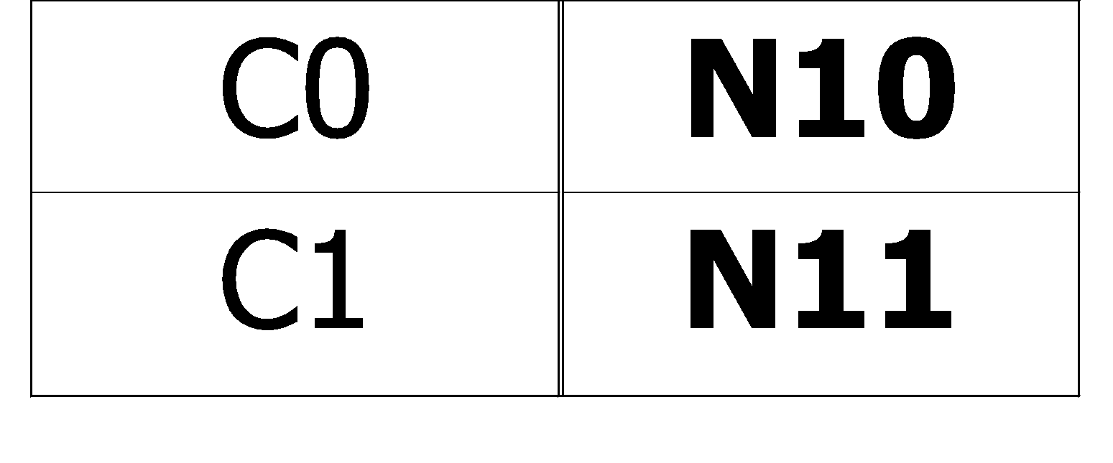
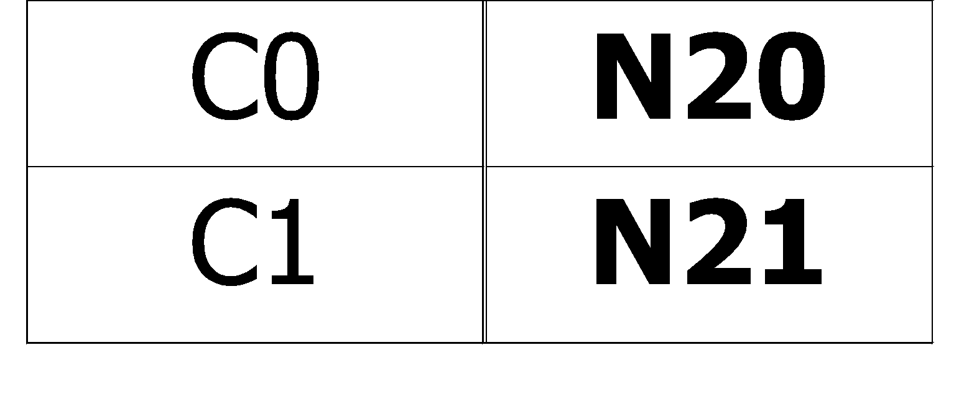
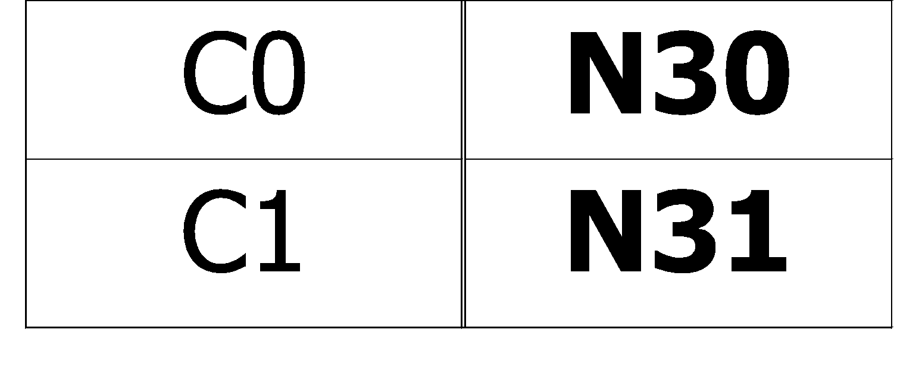
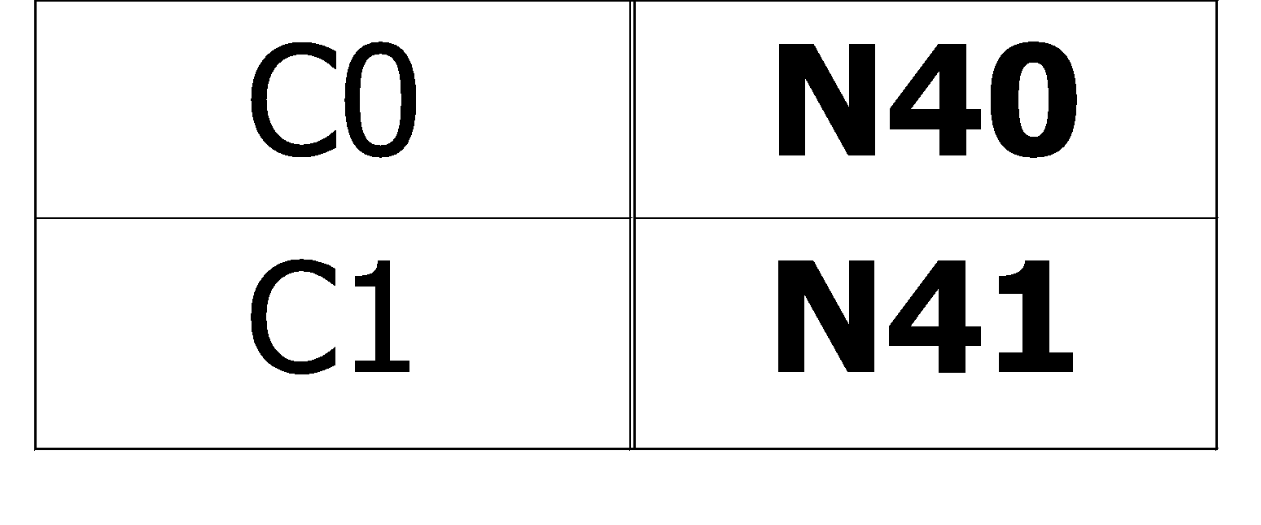
How to Find the Best Split
Before Splitting:
M0
A?
B?
Yes
No
Yes
No
Node N1
Node N2
Node N3
Node N4
M1
M2
M3
M4
M12
M34
Gain = M0 – M12 vs M0 – M34

Slide 31
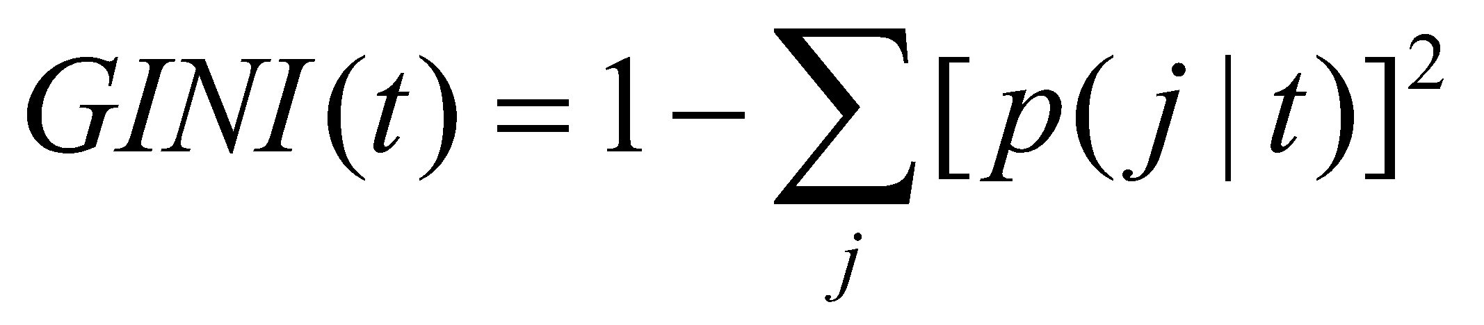
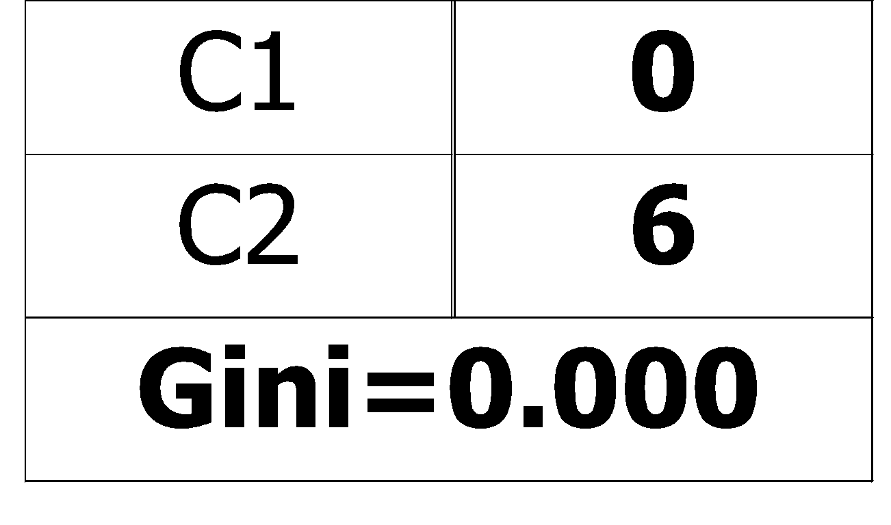
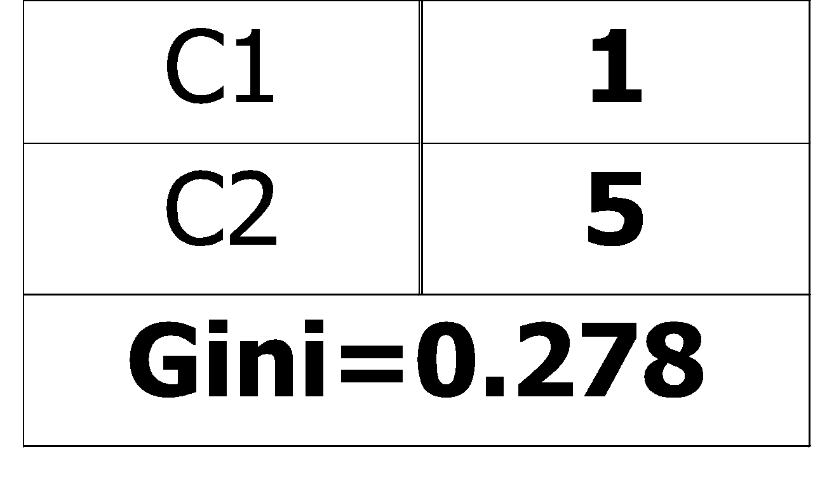
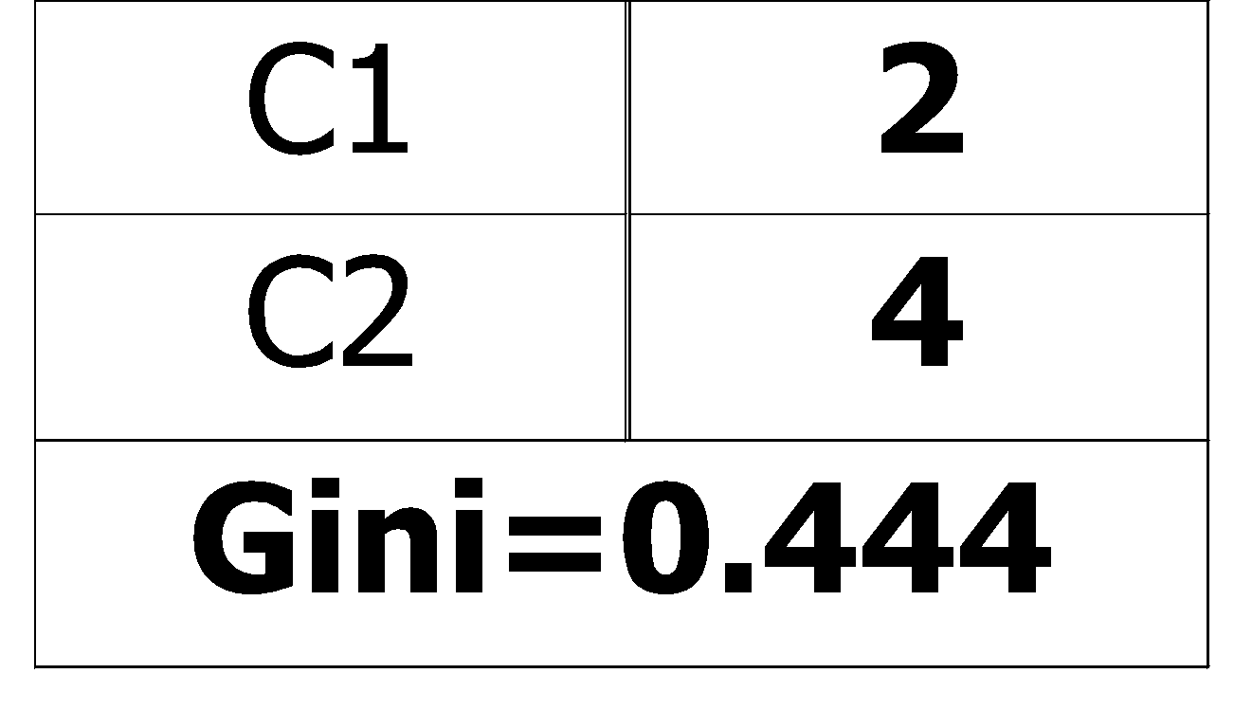
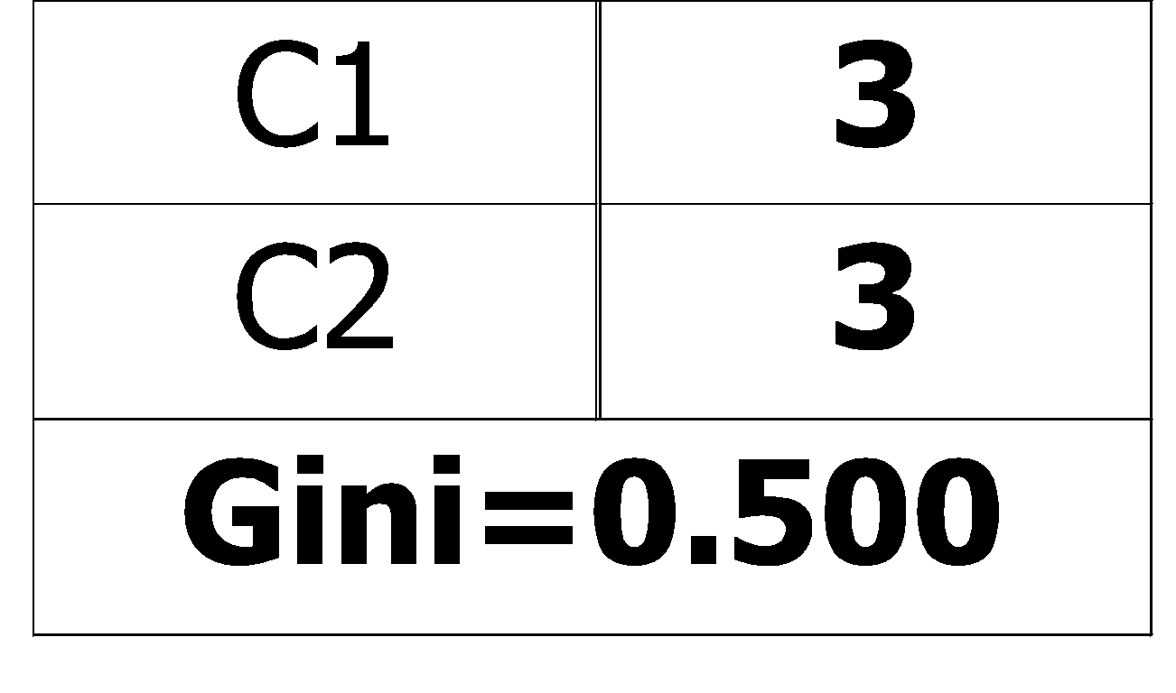
Measure of Impurity: GINI
Gini Index for a given node t :
(NOTE: p( j | t) is the relative frequency of class j at node t).
Maximum (1 - 1/n_{c}) when records are equally distributed among all classes, implying least interesting information
Minimum (0.0) when all records belong to one class, implying most interesting information

Slide 32
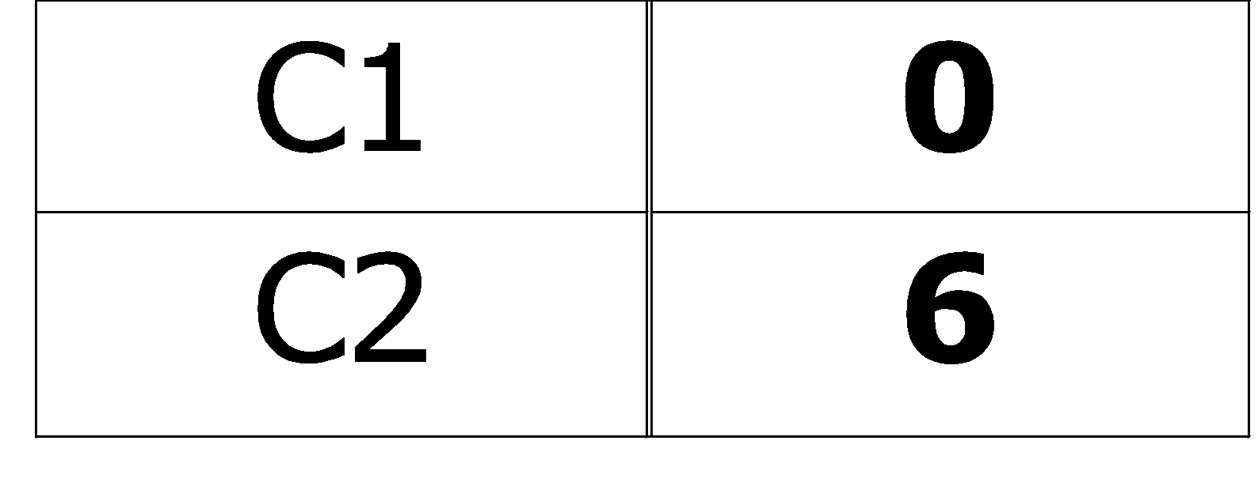
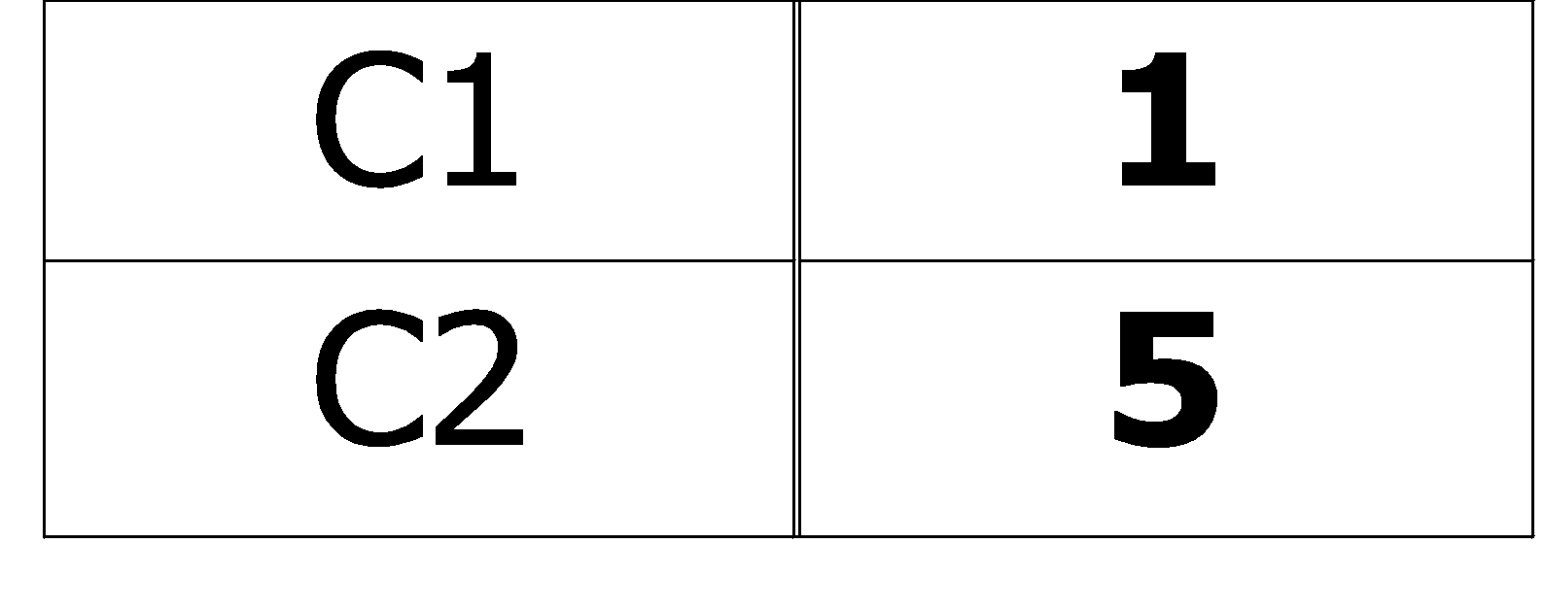
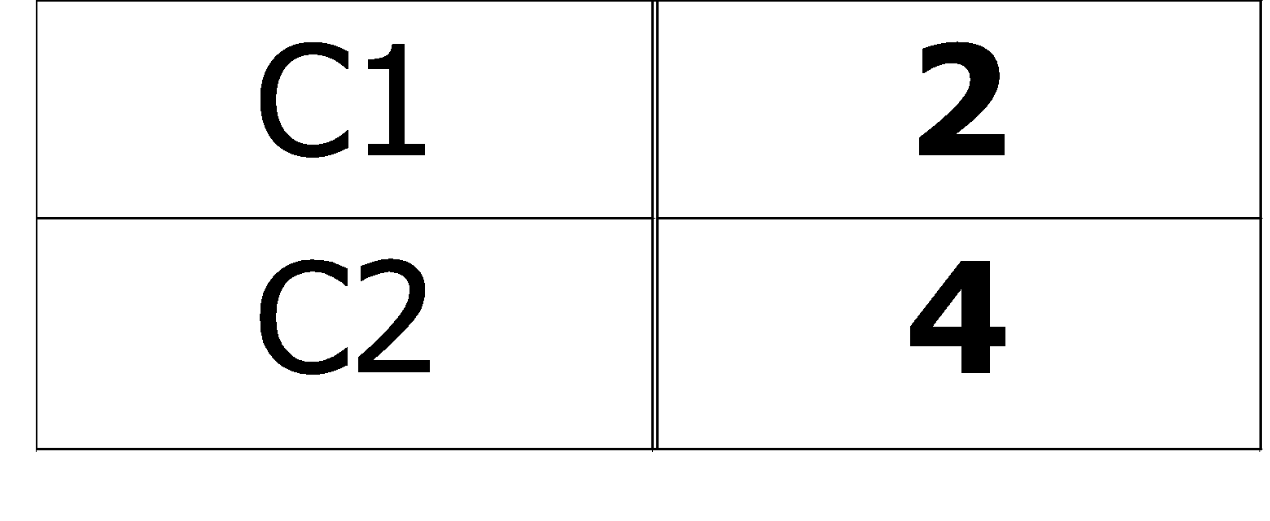
Examples for computing GINI
P(C1) = 0/6 = 0 P(C2) = 6/6 = 1
Gini = 1 – P(C1)² – P(C2)² = 1 – 0 – 1 = 0
P(C1) = 1/6 P(C2) = 5/6
Gini = 1 – (1/6)² – (5/6)² = 0.278
P(C1) = 2/6 P(C2) = 4/6
Gini = 1 – (2/6)² – (4/6)² = 0.444

Slide 33
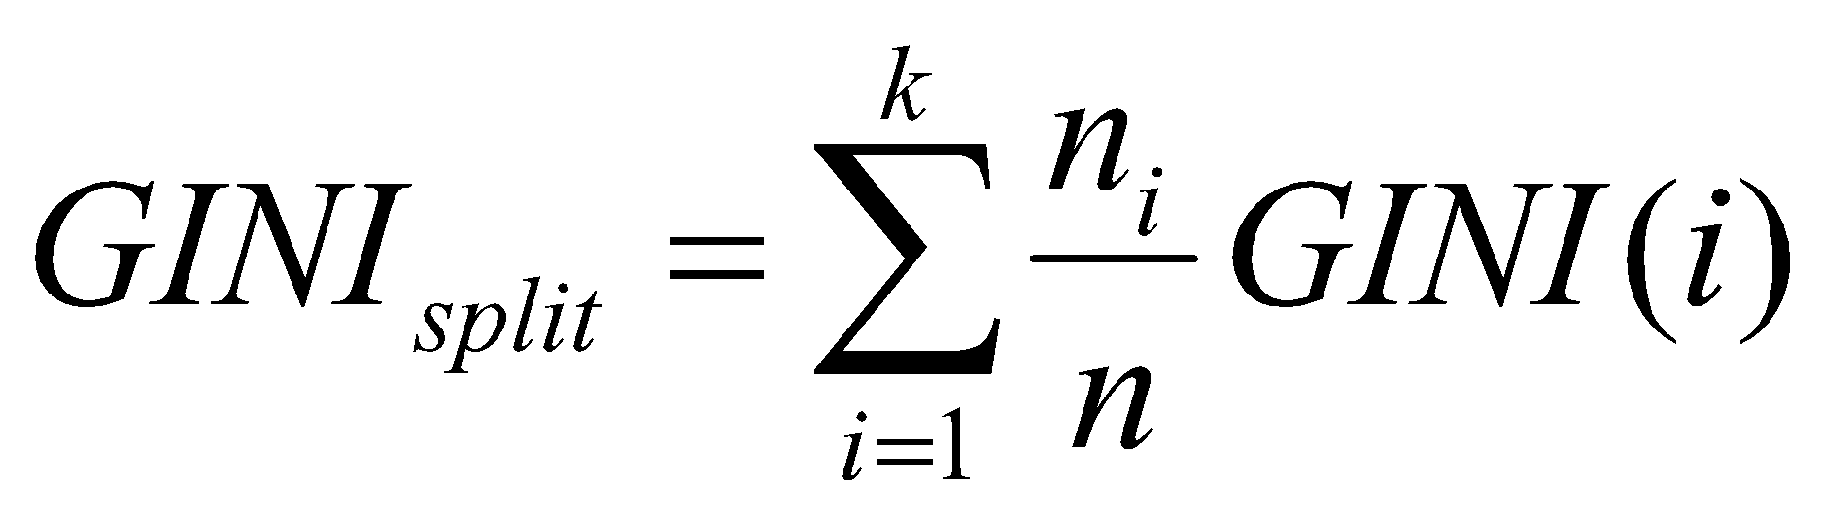
Splitting Based on GINI
Used in CART, SLIQ, SPRINT.
When a node p is split into k partitions (children), the quality of split is computed as,
where, n_{i} = number of records at child i,
n = number of records at node p.

Slide 34
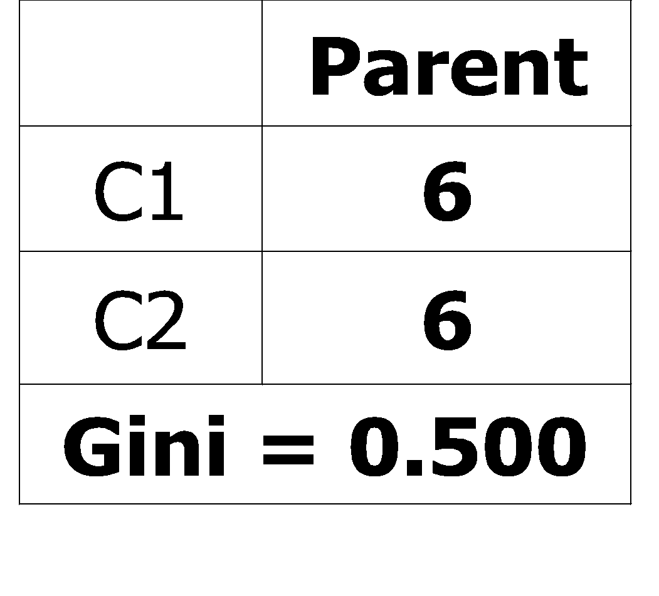
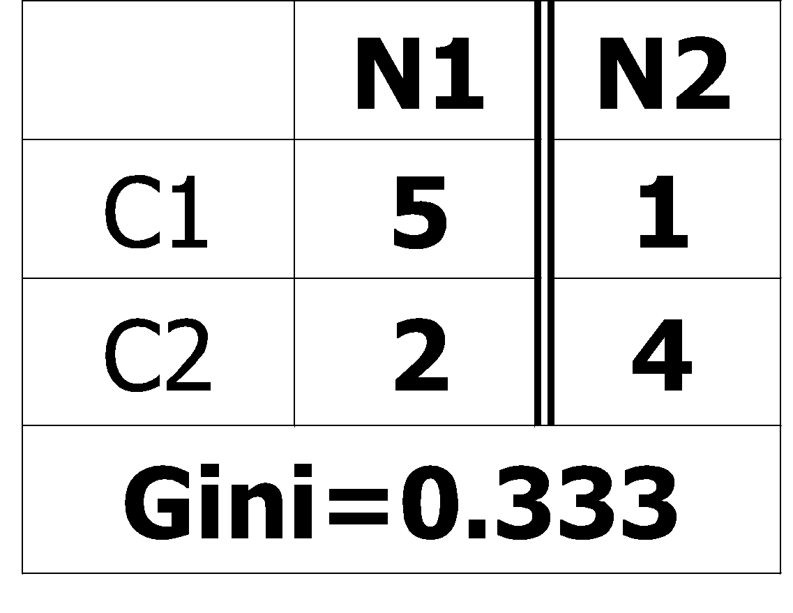
Binary Attributes: Computing GINI Index
Splits into two partitions
Effect of Weighing partitions:
Larger and Purer Partitions are sought for.
B?
Yes
No
Node N1
Node N2
Gini(N1) = 1 – (5/6)² – (2/6)² = 0.194
Gini(N2) = 1 – (1/6)² – (4/6)² = 0.528
Gini(Children) = 7/12 * 0.194 + 5/12 * 0.528 = 0.333

Slide 35
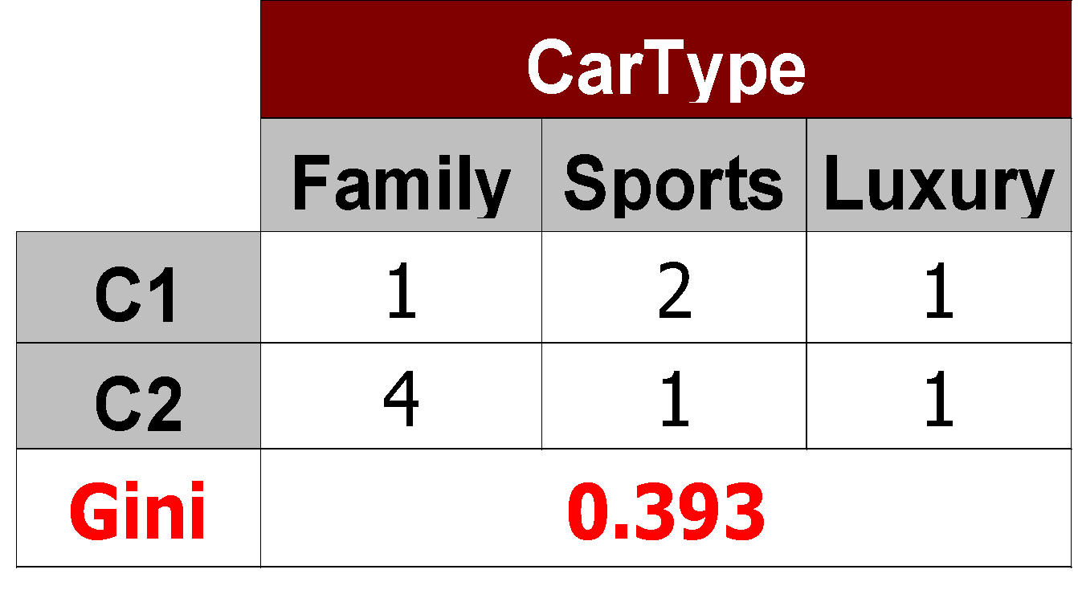
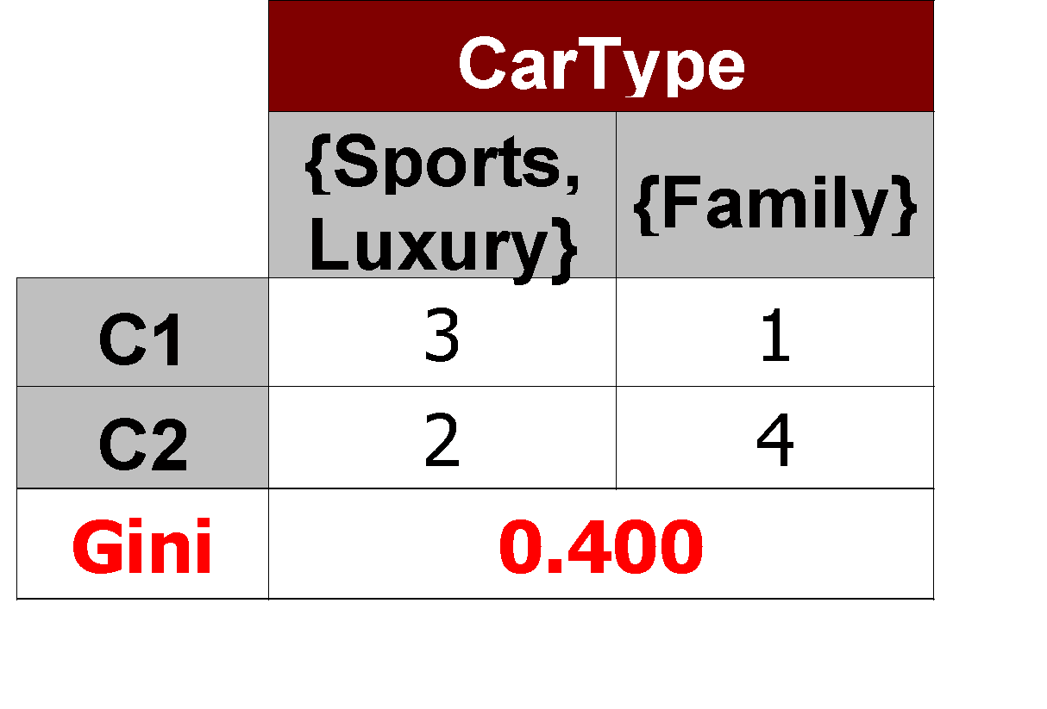
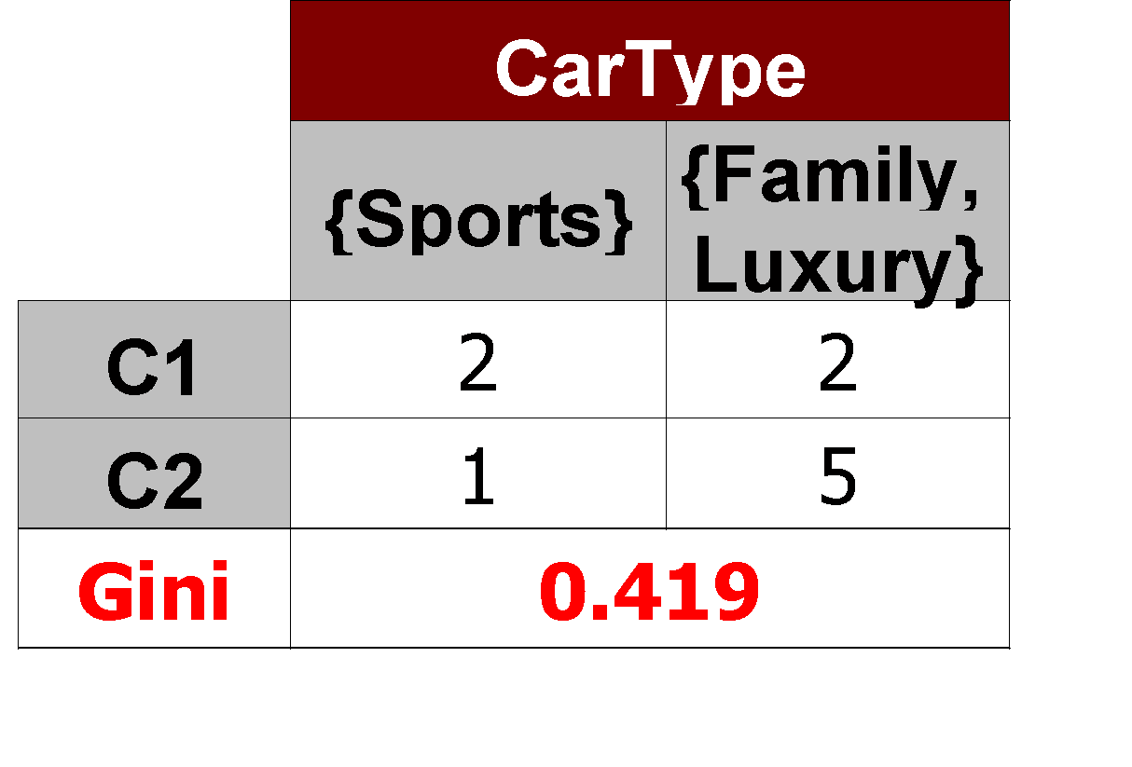
Categorical Attributes: Computing Gini Index
For each distinct value, gather counts for each class in the dataset
Use the count matrix to make decisions
Multi-way split
Two-way split
(find best partition of values)

Slide 36
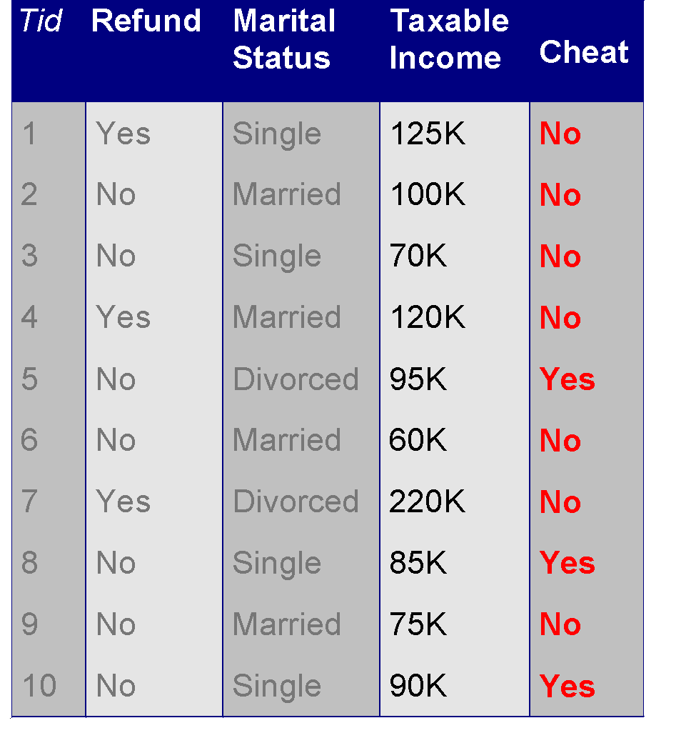
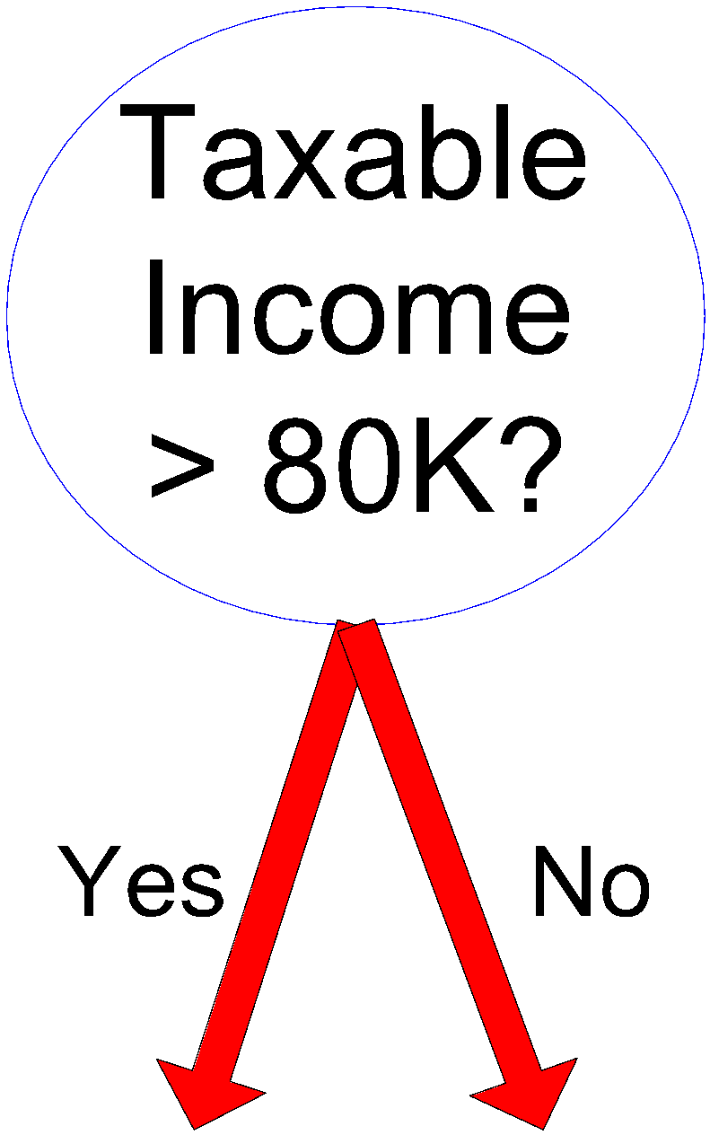
Continuous Attributes: Computing Gini Index
Use Binary Decisions based on one value
Several Choices for the splitting value
Number of possible splitting values = Number of distinct values
Each splitting value has a count matrix associated with it
Class counts in each of the partitions, A < v and A ≥ v
Simple method to choose best v
For each v, scan the database to gather count matrix and compute its Gini index
Computationally Inefficient! Repetition of work.

Slide 37
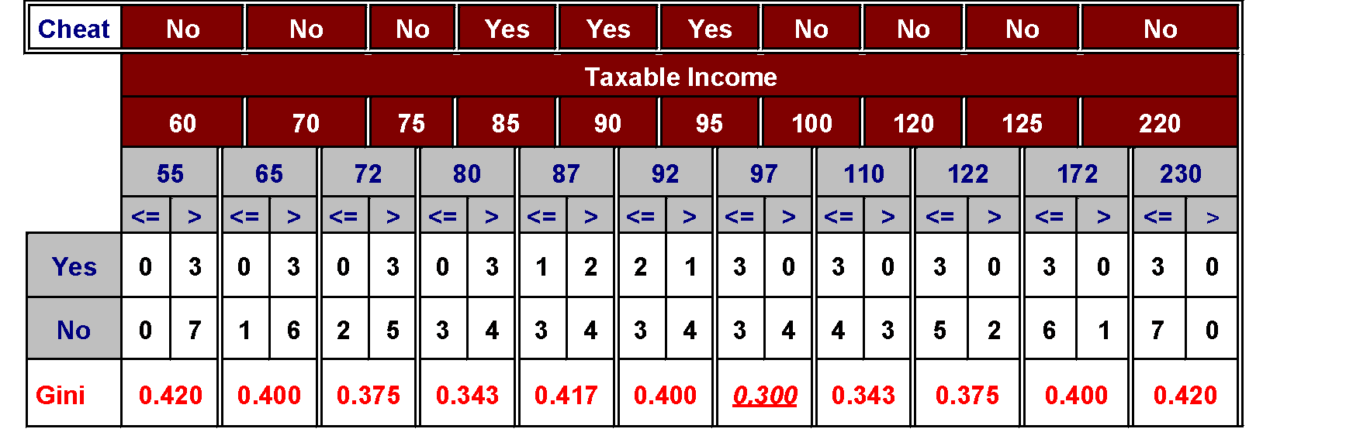
Continuous Attributes: Computing Gini Index...
For efficient computation: for each attribute,
Sort the attribute on values
Linearly scan these values, each time updating the count matrix and computing gini index
Choose the split position that has the least gini index
Sorted Values
Split Positions

Slide 38
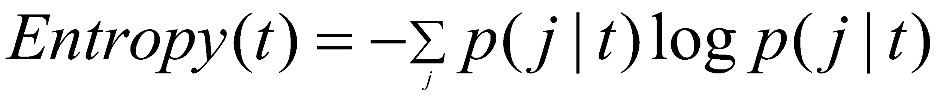
Alternative Splitting Criteria based on INFO
Entropy at a given node t:
(NOTE: p( j | t) is the relative frequency of class j at node t).
Measures homogeneity of a node.
Maximum (log n_{c}) when records are equally distributed among all classes implying least information
Minimum (0.0) when all records belong to one class, implying most information
Entropy based computations are similar to the GINI index computations

Slide 39
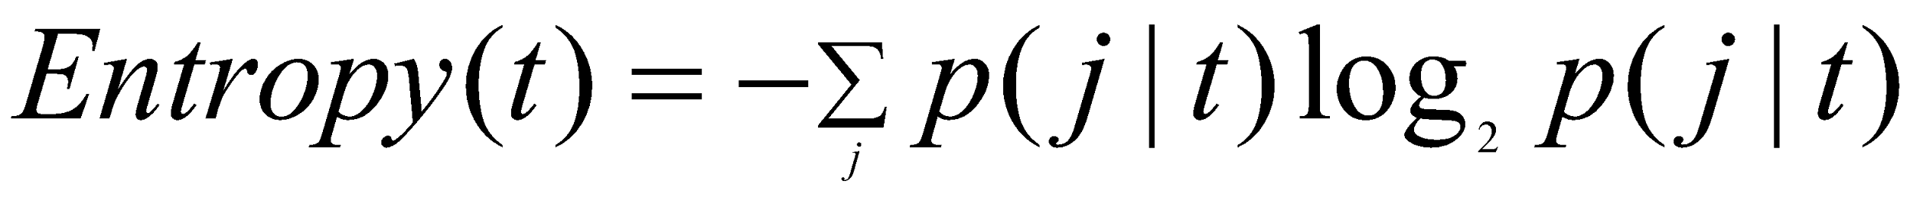
Examples for computing Entropy
P(C1) = 0/6 = 0 P(C2) = 6/6 = 1
Entropy = – 0 log 0 – 1 log 1 = – 0 – 0 = 0
P(C1) = 1/6 P(C2) = 5/6
Entropy = – (1/6) log₂ (1/6) – (5/6) log₂ (1/6) = 0.65
P(C1) = 2/6 P(C2) = 4/6
Entropy = – (2/6) log₂ (2/6) – (4/6) log₂ (4/6) = 0.92

Slide 40
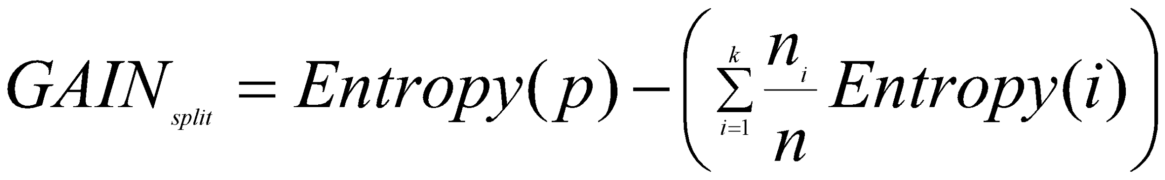
Splitting Based on INFO...
Information Gain:
Parent Node, p is split into k partitions;
n_{i} is number of records in partition i
Measures Reduction in Entropy achieved because of the split. Choose the split that achieves most reduction (maximizes GAIN)
Used in ID3 and C4.5
Disadvantage: Tends to prefer splits that result in large number of partitions, each being small but pure.

Slide 41
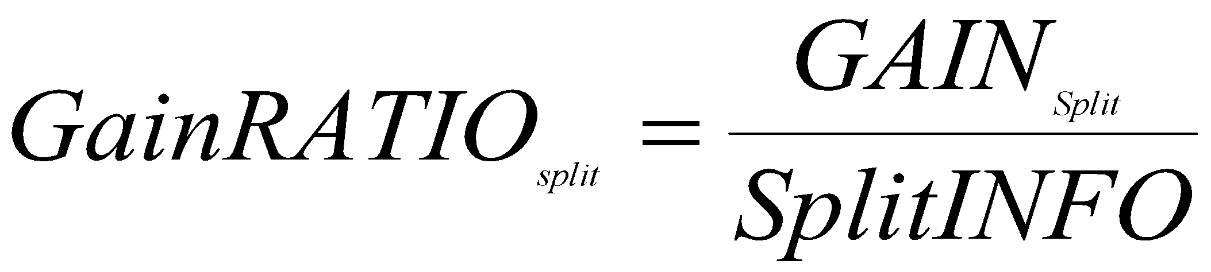
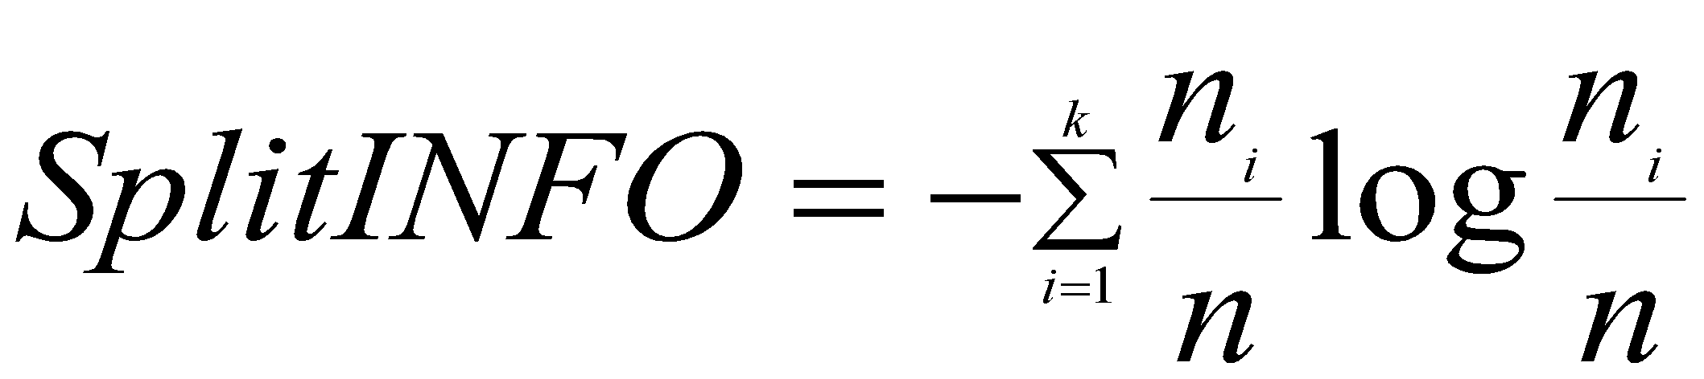
Splitting Based on INFO...
Gain Ratio:
Parent Node, p is split into k partitions
n_{i} is the number of records in partition i
Adjusts Information Gain by the entropy of the partitioning (SplitINFO). Higher entropy partitioning (large number of small partitions) is penalized!
Used in C4.5
Designed to overcome the disadvantage of Information Gain

Slide 42
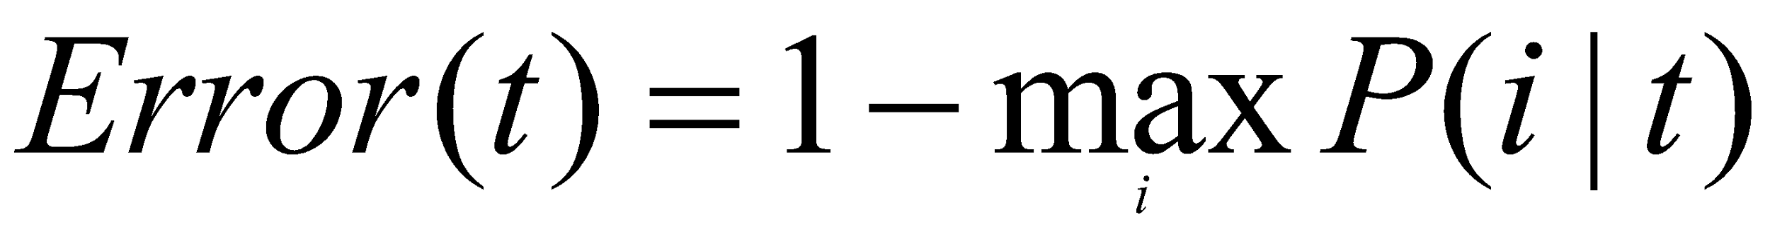
Splitting Criteria based on Classification Error
Classification error at a node t :
Measures misclassification error made by a node.
Maximum (1 - 1/n_{c}) when records are equally distributed among all classes, implying least interesting information
Minimum (0.0) when all records belong to one class, implying most interesting information

Slide 43
Examples for Computing Error
P(C1) = 0/6 = 0 P(C2) = 6/6 = 1
Error = 1 – max (0, 1) = 1 – 1 = 0
P(C1) = 1/6 P(C2) = 5/6
Error = 1 – max (1/6, 5/6) = 1 – 5/6 = 1/6
P(C1) = 2/6 P(C2) = 4/6
Error = 1 – max (2/6, 4/6) = 1 – 4/6 = 1/3

Slide 44
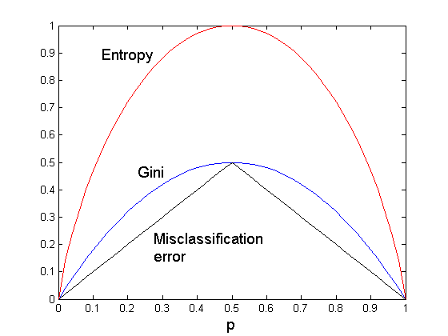
Comparison among Splitting Criteria
For a 2-class problem:

Slide 45
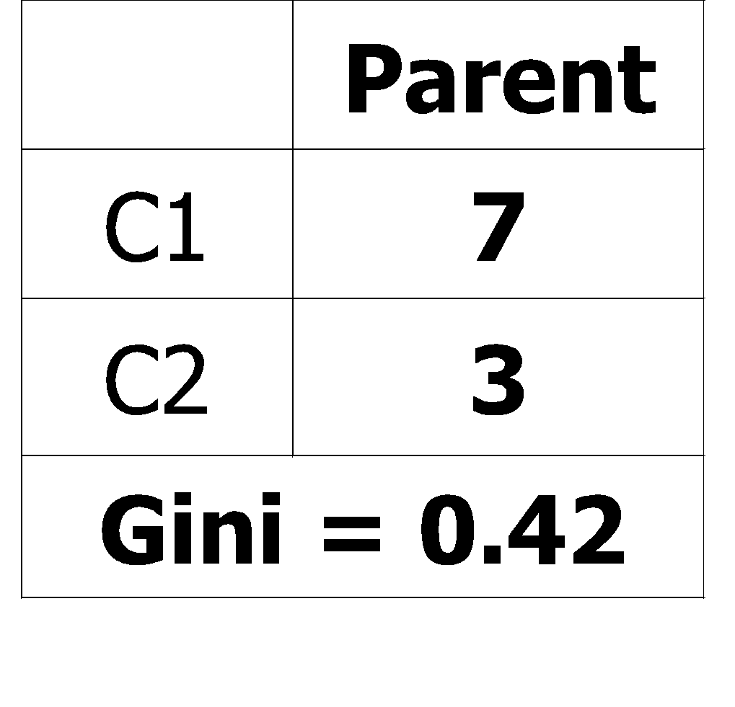
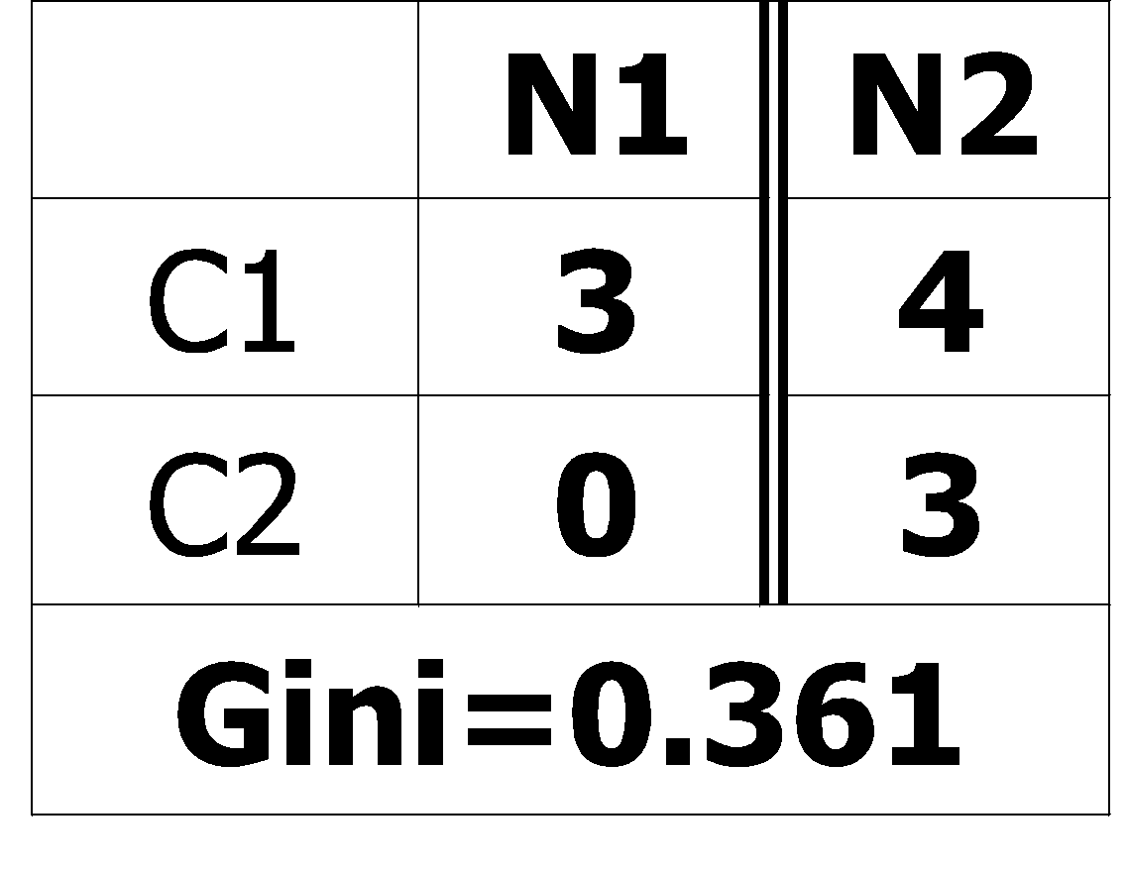
Misclassification Error vs Gini
A?
Yes
No
Node N1
Node N2
Gini(N1) = 1 – (3/3)² – (0/3)² = 0
Gini(N2) = 1 – (4/7)² – (3/7)² = 0.489
Gini(Children) = 3/10 * 0 + 7/10 * 0.489 = 0.342
Gini improves !!

Slide 46
Tree Induction
Greedy strategy.
Split the records based on an attribute test that optimizes certain criterion.
Issues
Determine how to split the records
How to specify the attribute test condition?
How to determine the best split?
Determine when to stop splitting

Slide 47
Stopping Criteria for Tree Induction
Stop expanding a node when all the records belong to the same class
Stop expanding a node when all the records have similar attribute values
Early termination (to be discussed later)

Slide 48
Decision Tree Based Classification
Advantages:
Inexpensive to construct
Extremely fast at classifying unknown records
Easy to interpret for small-sized trees
Accuracy is comparable to other classification techniques for many simple data sets

Slide 49
Example: C4.5
Simple depth-first construction.
Uses Information Gain
Sorts Continuous Attributes at each node.
Needs entire data to fit in memory.
Unsuitable for Large Datasets.
Needs out-of-core sorting.
You can download the software from: http://www.cse.unsw.edu.au/~quinlan/c4.5r8.tar.gz

Slide 50
Practical Issues of Classification
Underfitting and Overfitting
Missing Values
Costs of Classification

Slide 51
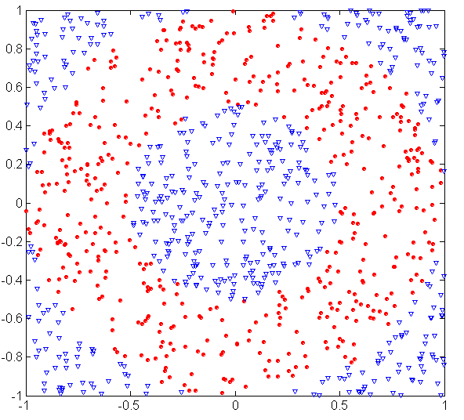
Underfitting and Overfitting (Example)
500 circular and 500 triangular data points.
Circular points:
0.5 ≤ sqrt(x₁²+x₂²) ≤ 1
Triangular points:
sqrt(x₁²+x₂²) > 0.5 or
sqrt(x₁²+x₂²) < 1

Slide 52
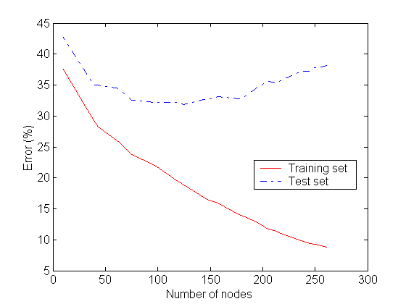
Underfitting and Overfitting
Overfitting
Underfitting: when model is too simple, both training and test errors are large

Slide 53
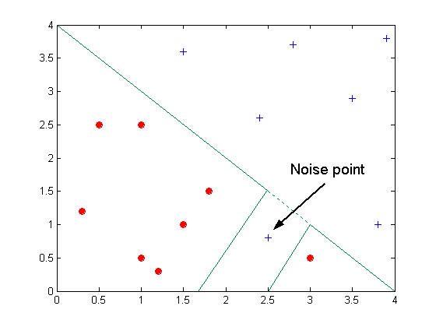
Overfitting due to Noise
Decision boundary is distorted by noise point

Slide 54
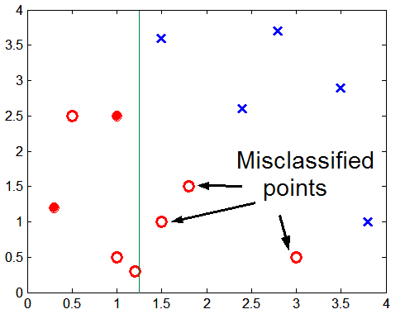
Overfitting due to Insufficient Examples
Lack of data points in the lower half of the diagram makes it difficult to predict correctly the class labels of that region
- Insufficient number of training records in the region causes the decision tree to predict the test examples using other training records that are irrelevant to the classification task

Slide 55
Notes on Overfitting
Overfitting results in decision trees that are more complex than necessary
Training error no longer provides a good estimate of how well the tree will perform on previously unseen records
Need new ways for estimating errors

Slide 56
Estimating Generalization Errors
Re-substitution errors: error on training (Σ e(t) )
Generalization errors: error on testing (Σ e’(t))
Methods for estimating generalization errors:
Optimistic approach: e’(t) = e(t)
Pessimistic approach:
For each leaf node: e’(t) = (e(t)+0.5)
Total errors: e’(T) = e(T) + N × 0.5 (N: number of leaf nodes)
For a tree with 30 leaf nodes and 10 errors on training (out of 1000 instances): Training error = 10/1000 = 1%
Generalization error = (10 + 30×0.5)/1000 = 2.5%
Reduced error pruning (REP):
uses validation data set to estimate generalization error

Slide 57
Occam’s Razor
Given two models of similar generalization errors, one should prefer the simpler model over the more complex model
For complex models, there is a greater chance that it was fitted accidentally by errors in data
Therefore, one should include model complexity when evaluating a model

Slide 58
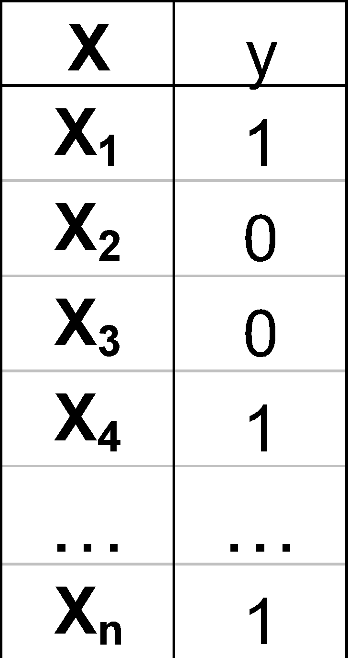
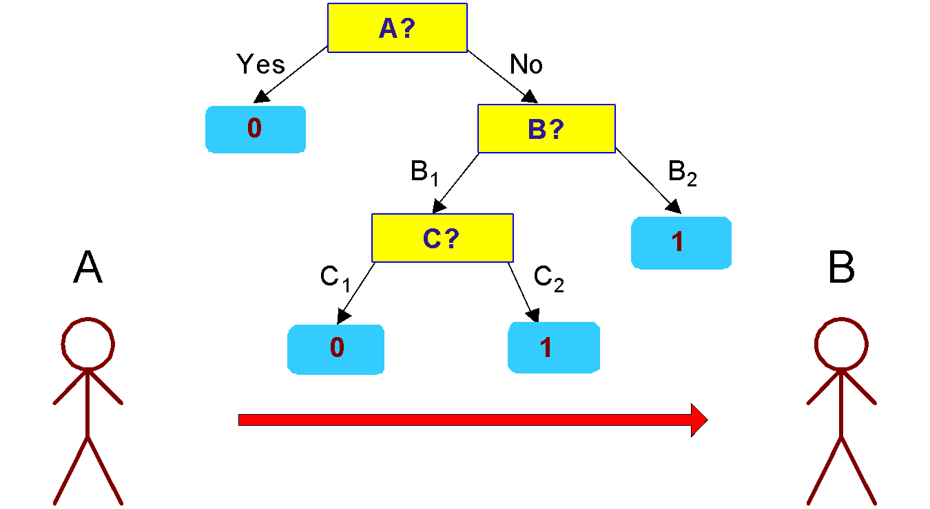
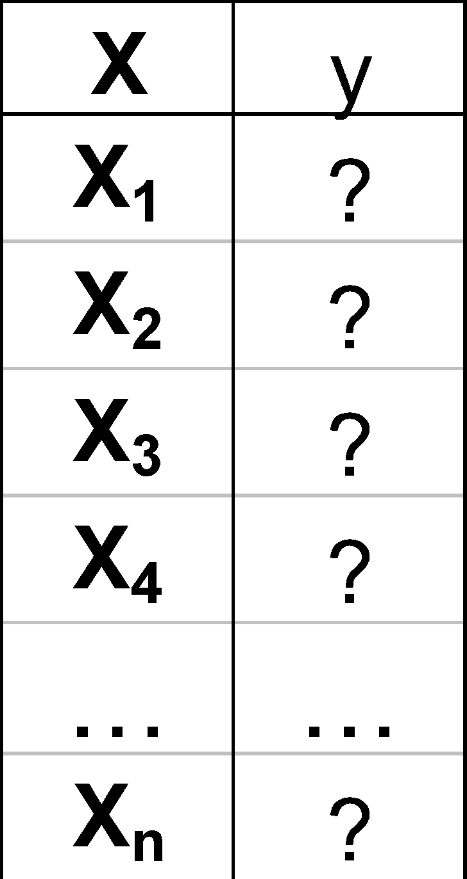
Minimum Description Length (MDL)
Cost(Model,Data) = Cost(Data|Model) + Cost(Model)
Cost is the number of bits needed for encoding.
Search for the least costly model.
Cost(Data|Model) encodes the misclassification errors.
Cost(Model) uses node encoding (number of children) plus splitting condition encoding.

Slide 59
How to Address Overfitting
Pre-Pruning (Early Stopping Rule)
Stop the algorithm before it becomes a fully-grown tree
Typical stopping conditions for a node:
Stop if all instances belong to the same class
Stop if all the attribute values are the same
More restrictive conditions:
Stop if number of instances is less than some user-specified threshold
Stop if class distribution of instances are independent of the available features (e.g., using χ ² test)
Stop if expanding the current node does not improve impurity measures (e.g., Gini or information gain).

Slide 60
How to Address Overfitting…
Post-pruning
Grow decision tree to its entirety
Trim the nodes of the decision tree in a bottom-up fashion
If generalization error improves after trimming, replace sub-tree by a leaf node.
Class label of leaf node is determined from majority class of instances in the sub-tree
Can use MDL for post-pruning

Slide 61

Example of Post-Pruning
Training Error (Before splitting) = 10/30
Pessimistic error = (10 + 0.5)/30 = 10.5/30
Training Error (After splitting) = 9/30
Pessimistic error (After splitting)
= (9 + 4 × 0.5)/30 = 11/30
PRUNE!
Class = Yes | 20
Class = No | 10
Error = 10/30
Class = Yes | 8
Class = No | 4
Class = Yes | 3
Class = No | 4
Class = Yes | 4
Class = No | 1
Class = Yes | 5
Class = No | 1

Slide 62
Examples of Post-pruning
Optimistic error?
Pessimistic error?
Reduced error pruning?
Case 1:
Don’t prune for both cases
C0: 11
C1: 3
C0: 2
C1: 4
Don’t prune case 1, prune case 2
Case 2:
Depends on validation set
C0: 14
C1: 3
C0: 2
C1: 2

Slide 63
Handling Missing Attribute Values
Missing values affect decision tree construction in three different ways:
Affects how impurity measures are computed
Affects how to distribute instance with missing value to child nodes
Affects how a test instance with missing value is classified

Slide 64


Computing Impurity Measure
Before Splitting: Entropy(Parent) = -0.3 log(0.3)-(0.7)log(0.7) = 0.8813
Split on Refund:
Entropy(Refund=Yes) = 0
Entropy(Refund=No) = -(2/6)log(2/6) – (4/6)log(4/6) = 0.9183
Entropy(Children) = 0.3 (0) + 0.6 (0.9183) = 0.551
Gain = 0.9 × (0.8813 – 0.551) = 0.3303
Missing value

Slide 65






Distribute Instances
Refund
Yes
No
Probability that Refund=Yes is 3/9
Probability that Refund=No is 6/9
Assign record to the left child with weight = 3/9 and to the right child with weight = 6/9
Refund
Yes
No

Slide 66

Classify Instances
New record:
 | Married | Single | Divorced | Total
Class=No | 3 | 1 | 0 | 4
Class=Yes | 6/9 | 1 | 1 | 2.67
Total | 3.67 | 2 | 1 | 6.67
Refund
Yes
No
NO
MarSt
Single, Divorced
Married
Probability that Marital Status = Married is 3.67/6.67
Probability that Marital Status ={Single,Divorced} is 3/6.67
TaxInc
NO
< 80K
> 80K
NO
YES

Slide 67
Other Issues
Data Fragmentation
Search Strategy
Expressiveness
Tree Replication

Slide 68
Data Fragmentation
Number of instances gets smaller as you traverse down the tree
Number of instances at the leaf nodes could be too small to make any statistically significant decision

Slide 69
Search Strategy
Finding an optimal decision tree is NP-hard
The algorithm presented so far uses a greedy, top-down, recursive partitioning strategy to induce a reasonable solution
Other strategies?
Bottom-up
Bi-directional

Slide 70
Expressiveness
Decision tree provides expressive representation for learning discrete-valued function
But they do not generalize well to certain types of Boolean functions
Example: parity function:
Class = 1 if there is an even number of Boolean attributes with truth value = True
Class = 0 if there is an odd number of Boolean attributes with truth value = True
For accurate modeling, must have a complete tree
Not expressive enough for modeling continuous variables
Particularly when test condition involves only a single attribute at-a-time

Slide 71

Decision Boundary
Border line between two neighboring regions of different classes is known as decision boundary
Decision boundary is parallel to axes because test condition involves a single attribute at-a-time

Slide 72

Oblique Decision Trees
x + y < 1
Class = +
Class =
Test condition may involve multiple attributes
More expressive representation
Finding optimal test condition is computationally expensive

Slide 73

Tree Replication
Same subtree appears in multiple branches

Slide 74
Model Evaluation
Metrics for Performance Evaluation
How to evaluate the performance of a model?
Methods for Performance Evaluation
How to obtain reliable estimates?
Methods for Model Comparison
How to compare the relative performance among competing models?

Slide 75
Model Evaluation
Metrics for Performance Evaluation
How to evaluate the performance of a model?
Methods for Performance Evaluation
How to obtain reliable estimates?
Methods for Model Comparison
How to compare the relative performance among competing models?

Slide 76
Metrics for Performance Evaluation
Focus on the predictive capability of a model
Rather than how fast it takes to classify or build models, scalability, etc.
Confusion Matrix:
 | PREDICTED CLASS
ACTUAL CLASS |  | Class=Yes | Class=No
 | Class=Yes | a | b
 | Class=No | c | d
a: TP (true positive)
b: FN (false negative)
c: FP (false positive)
d: TN (true negative)

Slide 77

Metrics for Performance Evaluation…
Most widely-used metric:
 | PREDICTED CLASS
ACTUAL CLASS |  | Class=Yes | Class=No
 | Class=Yes | a (TP) | b (FN)
 | Class=No | c (FP) | d (TN)

Slide 78
Limitation of Accuracy
Consider a 2-class problem
Number of Class 0 examples = 9990
Number of Class 1 examples = 10
If model predicts everything to be class 0, accuracy is 9990/10000 = 99.9 %
Accuracy is misleading because model does not detect any class 1 example

Slide 79
Cost Matrix
 | PREDICTED CLASS
ACTUAL CLASS | C(i|j) | Class=Yes | Class=No
 | Class=Yes | C(Yes|Yes) | C(No|Yes)
 | Class=No | C(Yes|No) | C(No|No)
C(i|j): Cost of misclassifying class j example as class i

Slide 80
Computing Cost of Classification
Cost Matrix | PREDICTED CLASS
ACTUAL CLASS | C(i|j) | + | -
 | + | -1 | 100
 | - | 1 | 0
Model M₁ | PREDICTED CLASS
ACTUAL CLASS |  | + | -
 | + | 150 | 40
 | - | 60 | 250
Model M₂ | PREDICTED CLASS
ACTUAL CLASS |  | + | -
 | + | 250 | 45
 | - | 5 | 200
Accuracy = 80%
Cost = 3910
Accuracy = 90%
Cost = 4255

Slide 81
Cost vs Accuracy
Count | PREDICTED CLASS
ACTUAL CLASS |  | Class=Yes | Class=No
 | Class=Yes | a | b
 | Class=No | c | d
Accuracy is proportional to cost if 1. C(Yes|No)=C(No|Yes) = q 2. C(Yes|Yes)=C(No|No) = p
N = a + b + c + d
Accuracy = (a + d)/N
Cost = p (a + d) + q (b + c)
= p (a + d) + q (N – a – d)
= q N – (q – p)(a + d)
= N [q – (q-p) × Accuracy]
Cost | PREDICTED CLASS
ACTUAL CLASS |  | Class=Yes | Class=No
 | Class=Yes | p | q
 | Class=No | q | p

Slide 82


Cost-Sensitive Measures
Precision is biased towards C(Yes|Yes) & C(Yes|No)
Recall is biased towards C(Yes|Yes) & C(No|Yes)
F-measure is biased towards all except C(No|No)

Slide 83
Model Evaluation
Metrics for Performance Evaluation
How to evaluate the performance of a model?
Methods for Performance Evaluation
How to obtain reliable estimates?
Methods for Model Comparison
How to compare the relative performance among competing models?

Slide 84
Methods for Performance Evaluation
How to obtain a reliable estimate of performance?
Performance of a model may depend on other factors besides the learning algorithm:
Class distribution
Cost of misclassification
Size of training and test sets

Slide 85

Learning Curve
Learning curve shows how accuracy changes with varying sample size
Requires a sampling schedule for creating learning curve:
Arithmetic sampling (Langley, et al)
Geometric sampling (Provost et al)
Effect of small sample size:
Bias in the estimate
Variance of estimate

Slide 86
Methods of Estimation
Holdout
Reserve 2/3 for training and 1/3 for testing
Random subsampling
Repeated holdout
Cross validation
Partition data into k disjoint subsets
k-fold: train on k-1 partitions, test on the remaining one
Leave-one-out: k=n
Stratified sampling
oversampling vs undersampling
Bootstrap
Sampling with replacement

Slide 87
Model Evaluation
Metrics for Performance Evaluation
How to evaluate the performance of a model?
Methods for Performance Evaluation
How to obtain reliable estimates?
Methods for Model Comparison
How to compare the relative performance among competing models?

Slide 88
ROC (Receiver Operating Characteristic)
Developed in 1950s for signal detection theory to analyze noisy signals
Characterize the trade-off between positive hits and false alarms
ROC curve plots TP (on the y-axis) against FP (on the x-axis)
Performance of each classifier represented as a point on the ROC curve
changing the threshold of algorithm, sample distribution or cost matrix changes the location of the point

Slide 89


ROC Curve
- 1-dimensional data set containing 2 classes (positive and negative)
- any points located at x > t is classified as positive
At threshold t:
TP=0.5, FN=0.5, FP=0.12, FN=0.88

Slide 90
ROC Curve
(TP,FP):
(0,0): declare everything to be negative class
(1,1): declare everything to be positive class
(1,0): ideal
Diagonal line:
Random guessing
Below diagonal line:
prediction is opposite of the true class

Slide 91

Using ROC for Model Comparison
No model consistently outperform the other
M₁ is better for small FPR
M₂ is better for large FPR
Area Under the ROC curve
Ideal:
Area = 1
Random guess:
Area = 0.5

Slide 92
How to Construct an ROC curve
Use classifier that produces posterior probability for each test instance P(+|A)
Sort the instances according to P(+|A) in decreasing order
Apply threshold at each unique value of P(+|A)
Count the number of TP, FP, TN, FN at each threshold
TP rate, TPR = TP/(TP+FN)
FP rate, FPR = FP/(FP + TN)
Instance | P(+|A) | True Class
1 | 0.95 | +
2 | 0.93 | +
3 | 0.87 | -
4 | 0.85 | -
5 | 0.85 | -
6 | 0.85 | +
7 | 0.76 | -
8 | 0.53 | +
9 | 0.43 | -
10 | 0.25 | +

Slide 93


How to construct an ROC curve
Threshold >=
ROC Curve:

Slide 94
Test of Significance
Given two models:
Model M1: accuracy = 85%, tested on 30 instances
Model M2: accuracy = 75%, tested on 5000 instances
Can we say M1 is better than M2?
How much confidence can we place on accuracy of M1 and M2?
Can the difference in performance measure be explained as a result of random fluctuations in the test set?

Slide 95
Confidence Interval for Accuracy
Prediction can be regarded as a Bernoulli trial
A Bernoulli trial has 2 possible outcomes
Possible outcomes for prediction: correct or wrong
Collection of Bernoulli trials has a Binomial distribution:
x ~ Bin(N, p) x: number of correct predictions
e.g: Toss a fair coin 50 times, how many heads would turn up? Expected number of heads = N×p = 50 × 0.5 = 25
Given x (# of correct predictions) or equivalently, acc=x/N, and N (# of test instances), Can we predict p (true accuracy of model)?

Slide 96



Confidence Interval for Accuracy
Area = 1 - α
For large test sets (N > 30),
acc has a normal distribution with mean p and variance p(1-p)/N
Confidence Interval for p:
Z_{α/2}
Z_{1- α /2}

Slide 97
Confidence Interval for Accuracy
Consider a model that produces an accuracy of 80% when evaluated on 100 test instances:
N=100, acc = 0.8
Let 1-α = 0.95 (95% confidence)
From probability table, Z_{α/2}=1.96
1-α | Z
0.99 | 2.58
0.98 | 2.33
0.95 | 1.96
0.90 | 1.65
N | 50 | 100 | 500 | 1000 | 5000
p(lower) | 0.670 | 0.711 | 0.763 | 0.774 | 0.789
p(upper) | 0.888 | 0.866 | 0.833 | 0.824 | 0.811

Slide 98


Comparing Performance of 2 Models
Given two models, say M1 and M2, which is better?
M1 is tested on D1 (size=n1), found error rate = e₁
M2 is tested on D2 (size=n2), found error rate = e₂
Assume D1 and D2 are independent
If n1 and n2 are sufficiently large, then
Approximate:

Slide 99


Comparing Performance of 2 Models
To test if performance difference is statistically significant: d = e1 – e2
d ~ N(d_{t},σ_{t}) where d_{t} is the true difference
Since D1 and D2 are independent, their variance adds up:
At (1-α) confidence level,

Slide 100

An Illustrative Example
Given: M1: n1 = 30, e1 = 0.15 M2: n2 = 5000, e2 = 0.25
d = |e2 – e1| = 0.1 (2-sided test)
At 95% confidence level, Z_{α/2}=1.96 => Interval contains 0 => difference may not be statistically significant

Slide 101

Comparing Performance of 2 Algorithms
Each learning algorithm may produce k models:
L1 may produce M11 , M12, …, M1k
L2 may produce M21 , M22, …, M2k
If models are generated on the same test sets D1,D2, …, Dk (e.g., via cross-validation)
For each set: compute d_{j} = e_{1j} – e_{2j}
d_{j} has mean d_{t} and variance σ_{t}
Estimate:

